Slide 1

What is a Robot
Goals
To help students understand what a robot is
To understand the basic components needed for a robot
Mechanical Structure, Effectors, Power, Computer, Sensors, Computer Program
To understand the types of tasks and jobs robots perform
To learn terms and vocabulary related to robots
Preparation
Project slides up on a board or provide print outs for each group
Activity
Follow the slides and complete the activities

Slide 2

What is a Robot? Activity
Objectives:
What is a robot?
What do you need to build and control a robot?
What types of tasks/jobs do robots perform?
What terms do we need to know?

Slide 3
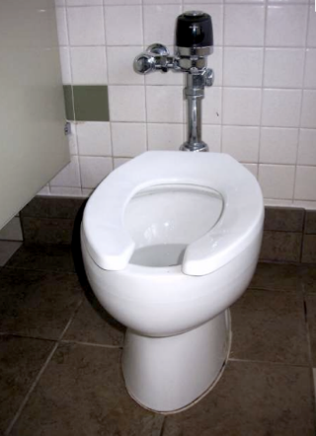
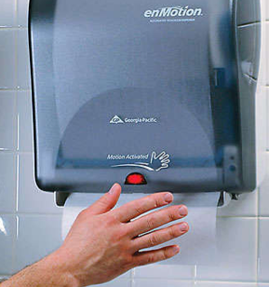
What robots do we use everyday?
Create a poster/list that describes what robots we use everyday, and why these are robots
Share out!
Compile a list of the robots
?

Slide 4
What makes a robot a robot?
List 5 or 6 words or phrases that you think make a robot a robot:

Slide 5

Commit and Toss
Draw a “+” if you agree
Add one more component
Toss
Notes:
Students crumple up their paper and toss it. Then pick up a different paper.

Slide 6
Can we add to it?
Structure
Effectors
Sensors
Power
Computation
Information
Notes:
Give each group of students a different component of what makes up a robot; provide them with reading material/ Have each group comprise a definition from the material provided. Each group shares out! Students record in notebooks.
JIGSAW

Slide 7
Humans vs. Robot Subsystems
People Robots
Bones Mechanical Structure
Muscles Effectors
Senses Sensors
Digestion/Respiration Power
Brain Computer
Knowledge Computer Program

Slide 8
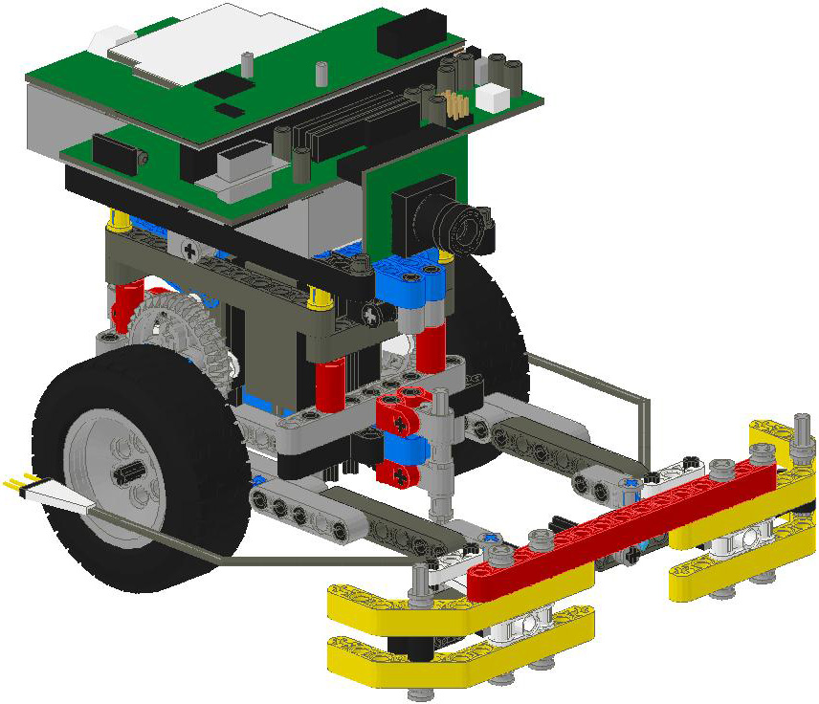
Structure
Robot Structure
Provides support to the robot-like your skeleton
Joints in structure normally have effectors (like muscles) attached
Holds sensors in position

Slide 9
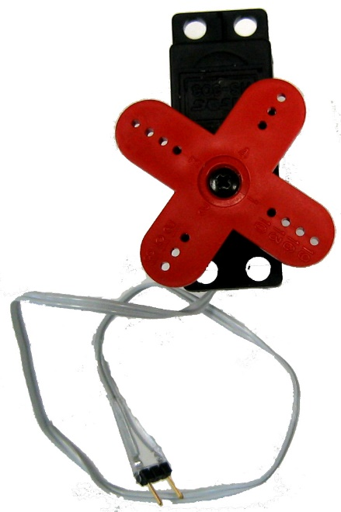
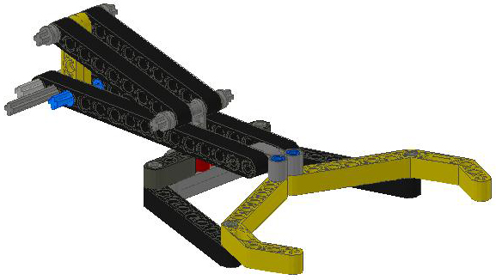
Effectors
Used to change the state of the robot itself
Used to change the state of the world
Examples:
Motors, thrusters, arms, or legs
Voice synthesizers, buzzers, and lights

Slide 10
Sensors
Proprioceptive sensors
Report on the current state of the robot- you know you are sitting down even with your eyes closed
External sensors
Report on the current state of the environment the robot is in
Light sensors, range sensors, touch sensors, etc.

Slide 11
Power (Energy)
Power Source
Batteries, solar panels
Springs, hydraulics, pneumatics
Nuclear reactor
Power Distribution
Wires
Power management
Regulators
Converters

Slide 12
Computation
Used to interpret sensor values; perception
Used to generate proper effector commands
Used to project effects and plan actions

Slide 13
Information
Internal Information
How to interpret sensor values
How to generate effector commands
Internal state & history
External Information
World, user & predictive models
Program
Determines robot actions
Forms robot plans
Debugging - introspection

Slide 14
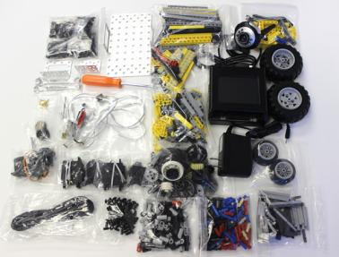
Introductory Kit Overview
#1 KIPR Link Controller
#1 KIPR Link Power Adapter
#1 KIPR Link Mini USB Cable
#1 Botball Screwdriver
#1 11/32 Wrench
#1 1/4 Wrench
#1 Introductory LEGO bag
#2 Motors - SG-5010 Standard Motor
#2 SG-5010 Servos
#1 Bag of Screws & Stand-offs
#1 Bag of Push Rivets
#1 Bag of Brass Screws
KIPR Metal Parts to include:
#1 Metal Ball Caster
#2 Motor Brackets
#1 Chassis
#1 Angle Bracket
#2 Servo Round Horn, #1 Long Horn
Sensors to include:
#1 Light Sensor
#1 Small Touch
#1 Large Touch
#1 Long Lever Sensor
#1 ET Rangefinder
#2 Small IR
You can access the kit components on our online store:
http://botballstore.org/product/link-Introductory-kit

Slide 15
Introductory Kit Scavenger Hunt Activity
Goals
Learn the kit components and be able to identify individual parts
Be able to group parts into categories (KIPR Metal Parts, LEGO, Sensors)
Distinguish between a motor and a servo motor
Keep track of parts
Preparation
Place all of the kit components out on a table and have the students use:
A checklist (something very helpful in engineering) to identify and account for all parts (printable example on next slide)
Have the students use their science/engineering/robotics notebook to make
their own checklist to account for all parts
Resources
The online KIPR store is a good resource to help with the identification of specific kit components:
http://botballstore.org/product/link-Introductory-kit
(instructions on resource slide)
*Having a tool box or plastic bins with lids to store kit components is
helpful and keeps them from getting lost in the classroom

Slide 16
Introductory Kit Checklist
#1 KIPR Link Controller
#1 KIPR Link Power Adapter
#1 KIPR Link Mini USB Cable
#1 Botball Screwdriver
#1 11/32 Wrench
#1 1/4 Wrench
#1 Introductory LEGO bag
#2 Motors - SG-5010 Motor
#2 SG-5010 Servos
#1 Bag of Screws & Stand-offs
#1 Bag of Push Rivets
#1 Bag of Brass Screws
KIPR Metal Parts to include:
#1 Metal Ball Caster
#2 Motor Brackets
#1 Chassis
#1 Angle Bracket
#2 Servo Round Horn
#1 Long Servo Horn
Sensors to include:
#1 Light Sensor
#1 Small Touch
#1 Large Touch
#1 Long Lever Sensor
#1 ET Rangefinder
#2 Small IR

Slide 17


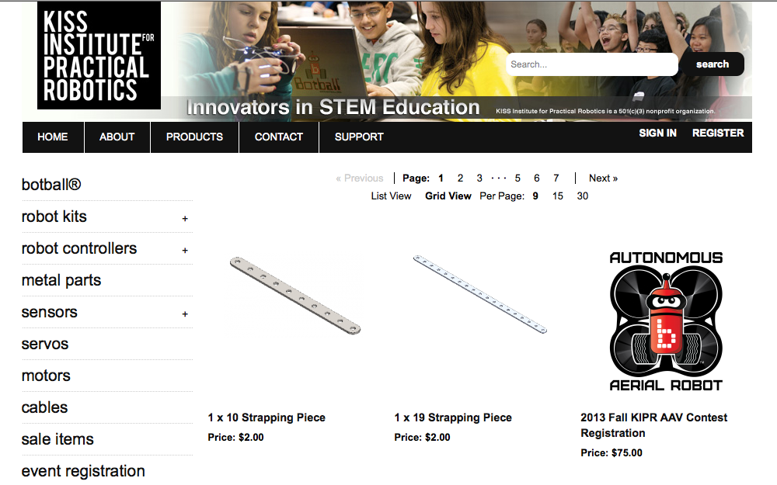

Online Resources-The Botball Store
www.botball.org
www.kipr.org

Slide 18
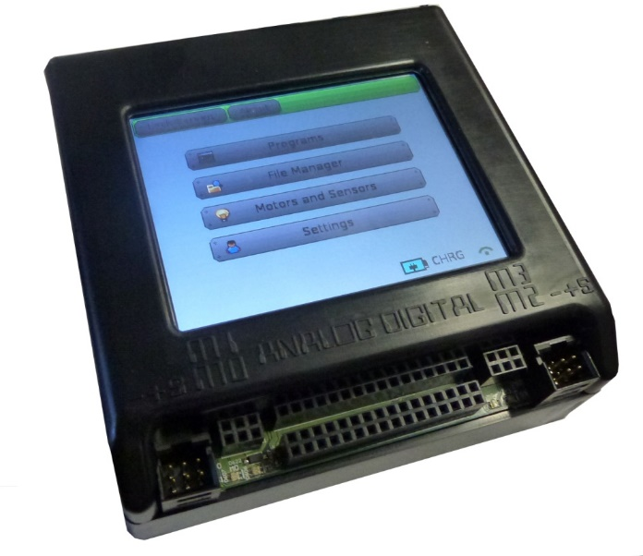
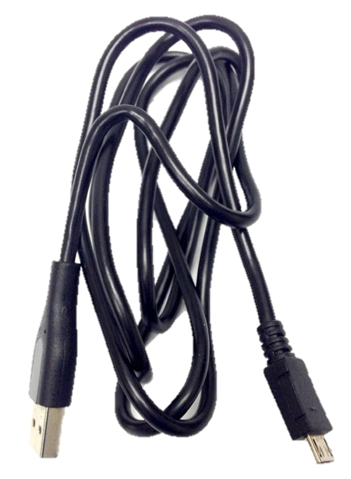
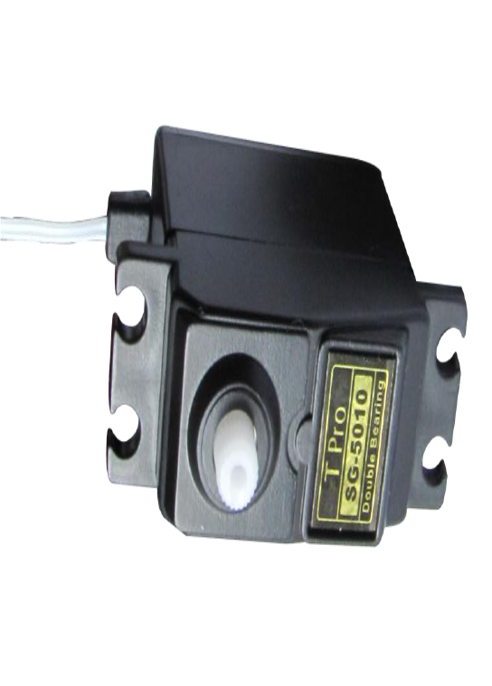
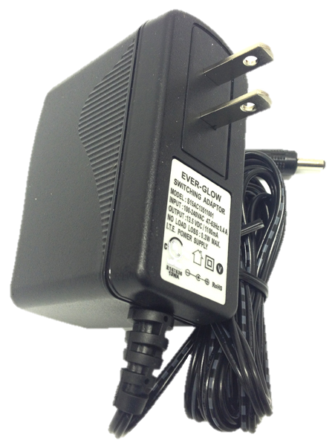
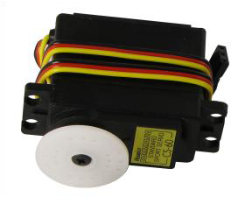
Resources- If you can’t get online
USB – micro USB
download cable
KIPR Link Controller
Motor
KIPR Link Wall Charger
(ONLY use this charger with your Link)
Servo Motor

Slide 19
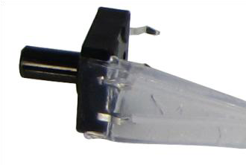
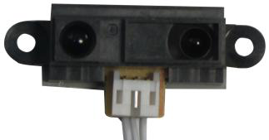
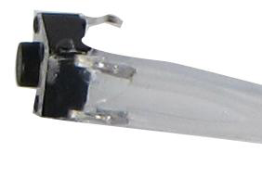
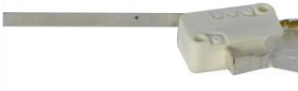
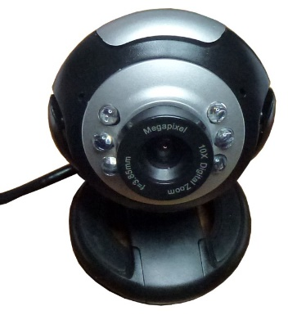
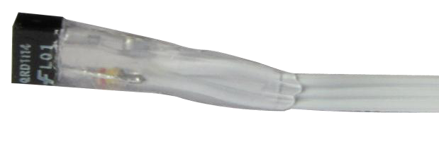
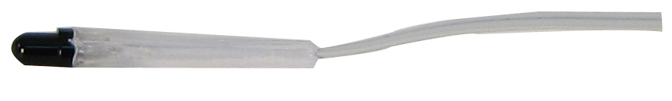
Resources- If you can’t get online continued
Large Touch Sensor
ET- Rangefinder sensor
Long Lever Sensor
Small Touch Sensor
USB Camera
Small IR Reflectance Sensor
Light Sensor

Slide 20
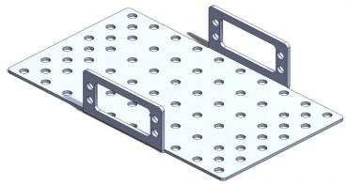
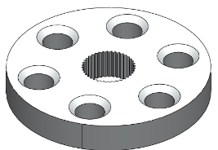
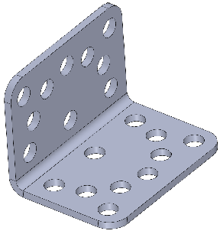
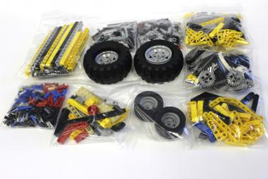
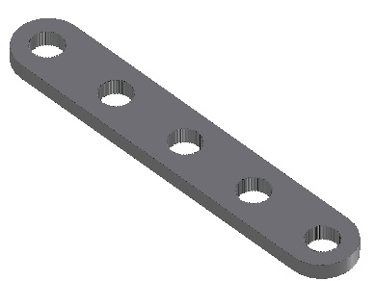
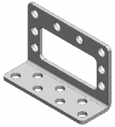
Resources- If you can’t get online continued
KMP Round Servo Horn
KIPR Metal Part (KMP) Chassis
KMP Angle Bracket
KMP Long Servo Horn
LEGO Bag
KMP Motor Bracket

Slide 21
Introductory Kit Scavenger Hunt
Task-
Sort and identify all of the robot kit components and use a checklist to make sure you have everything
OR
Generate your own checklist using your notebook and sort and identify all of the robot kit components
THEN
Use a Venn diagram to compare and contrast motors and servo motors
Be the expert- each team member must describe and identify a kit component explaining how they identified it until all items have been correctly identified
Motors
Servo Motors

Slide 22
Building the DemoBot
Goals
To get a robot built to complete the programming activities
To learn to follow directions/schematics to construct the robot
Preparation
Make sure if your robot is NOT already built to complete the Introductory Kit Overview Activity
Using the guide, have the student build the DemoBot
The teacher can build the DemoBot ahead of time if desired
*HINT- The hardest part is starting the screws through the metal servo horn to attach the tire. Students may need help starting the screws.
Activity
Using the slides, build the DemoBot

Slide 23
KIPR DemoBot

Slide 24
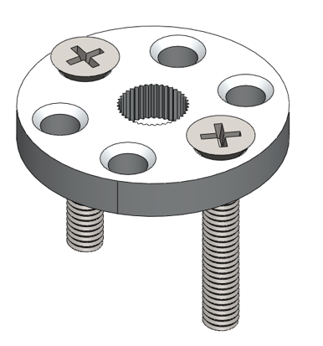
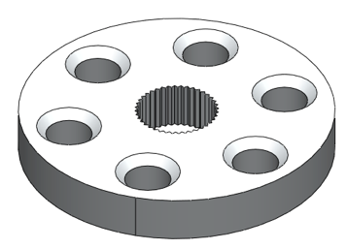
From the bag with two KIPR Metal Pieces (KMP) servo horns and two KMP servo arms remove the two round horns and four machine screws
Using the screwdriver start the machine screws through two opposite holes in the metal round servo horn
(It may be hard to get them started- teacher may need to help)

Slide 25
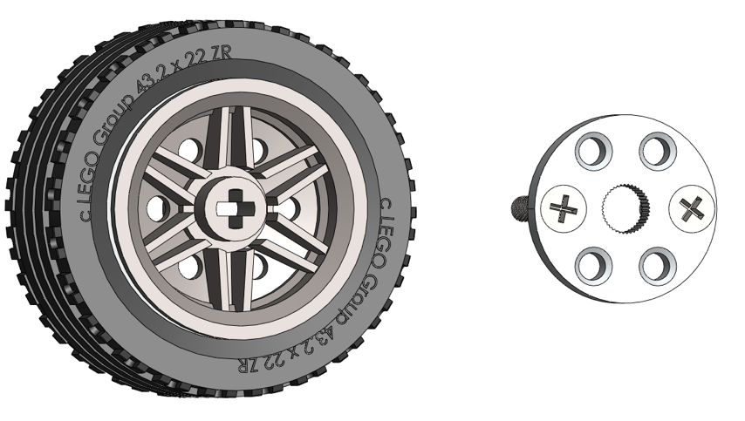
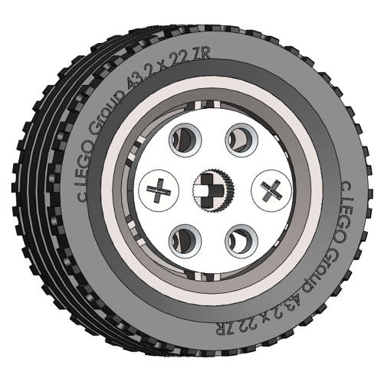
You will need two tires on rims
The KMP round servo horn with the two screws will go onto the side of the rim that is recessed the least amount

Slide 26
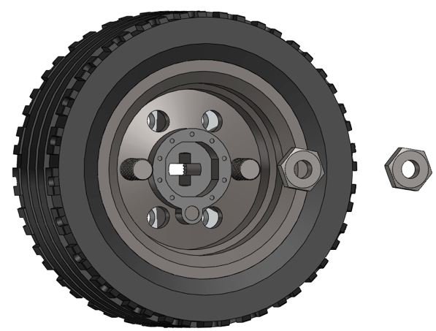
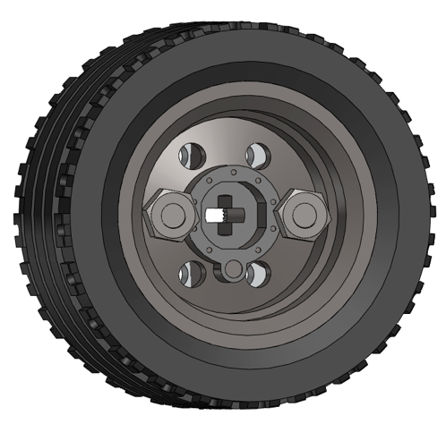
Using the nuts (from the bag with the KMP servo horns) and a screwdriver, attach the KMP round servo horn to the rim
You will attach these to the motors later in the build

Slide 27
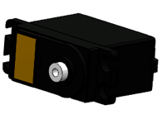
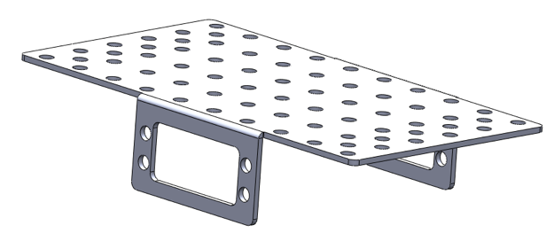
You will need two motors and the KMP Chassis
The kit has two (2) motors and two servos. You can distinguish motors from servos by the wiring. Motors have a double grey wire and servos have a triple red, orange, brown wire.

Slide 28
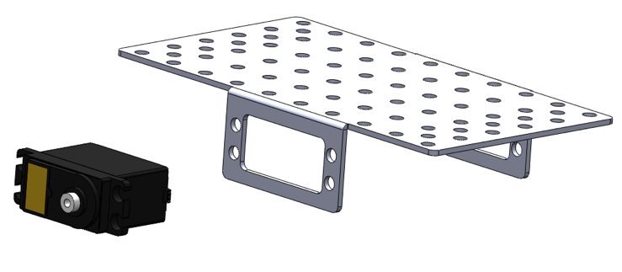
Long Side
Short Side
Servo Spindle
Insert the motors into the chassis
Make sure and place the white servo spindle towards (closer to) the shorter side of the chassis
Repeat for the other side

Slide 29
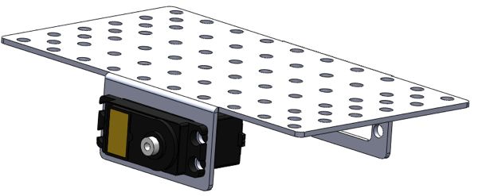
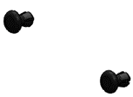
Using two plastic pop rivets attach the motors to the chassis and repeat the process on the other side with the other motor.
For a more stable connection you can use the short bolts and nuts instead of pop rivets.

Slide 30
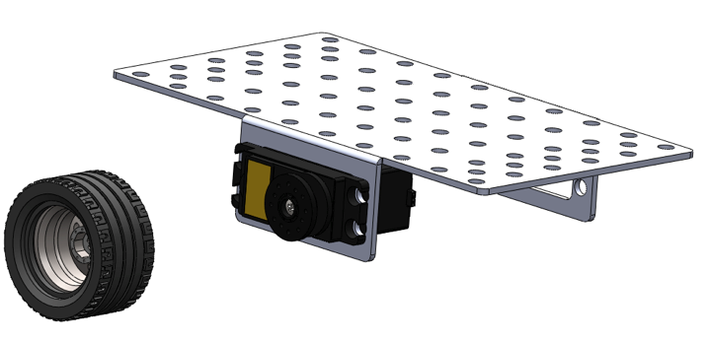
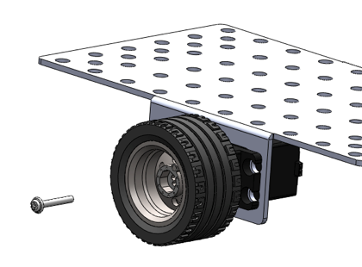
Using the wheels you assembled earlier, push the round metal servo horn onto the servo spindle
Using the screwdriver, secure the wheel in place with a long screw (found in the same bag with the KMP round and arm servo horns)
Repeat for other side

Slide 31
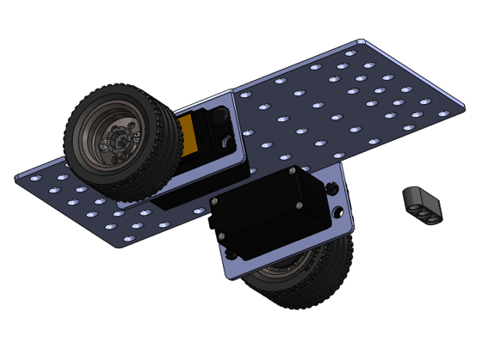
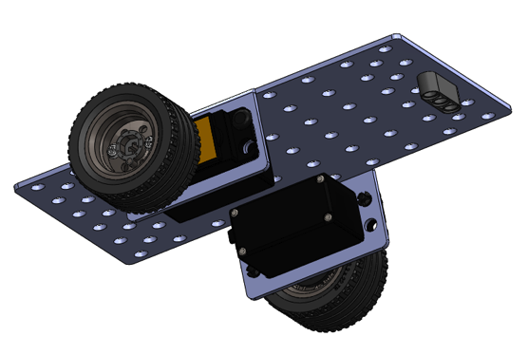
Take one (1) 3-Hole LEGO piece.
This shows the position that it will be mounted in the next few slides.

Slide 32
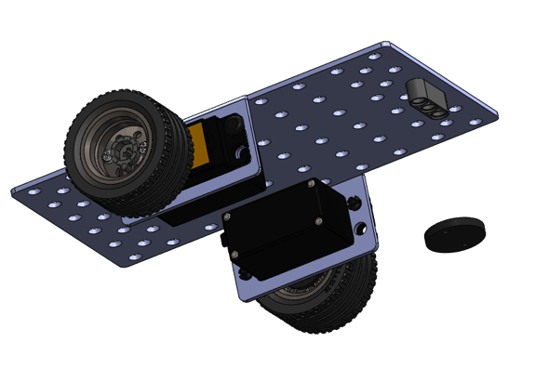
Get the “Pololu Ball Caster”.
The bag will contain a ball bearing caster, 2 short & 2 long bolts with nuts and two plastic washers- one thick and one thin. The washer in this slide is the THICK one and is shown here for position only (it will be attached in later slides).

Slide 33
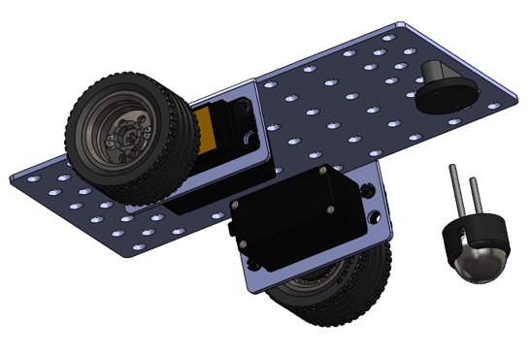
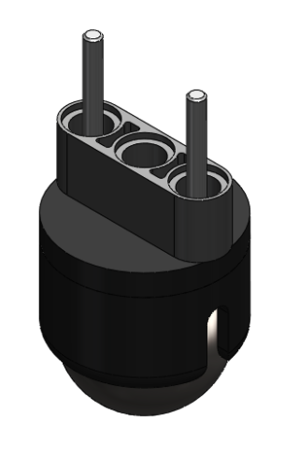
Take the ball bearing caster and the 2 long bolts from the “Pololu Ball Caster” bag. Pop the ball out of the caster. Leave the ball out for now. Put the bolts through the caster, the thick washer and the 3 hole LEGO as shown. The assembly is shown here for position only (it will be attached in later slides).

Slide 34
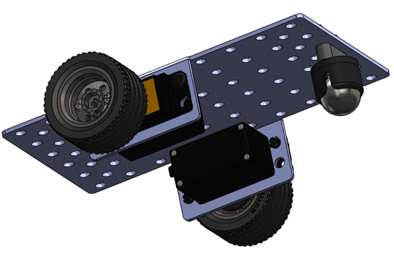
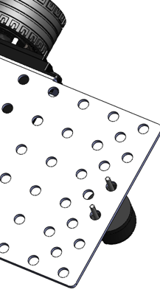
Place everything in place (3 Hole LEGO, Thick Washer, Ball Bearing Caster with 2 long bolts) into position. You will have to hold this in place until it is secured in the next slide. You can have a partner help or you can rest the caster assembly on the table so that it stays in place.

Slide 35
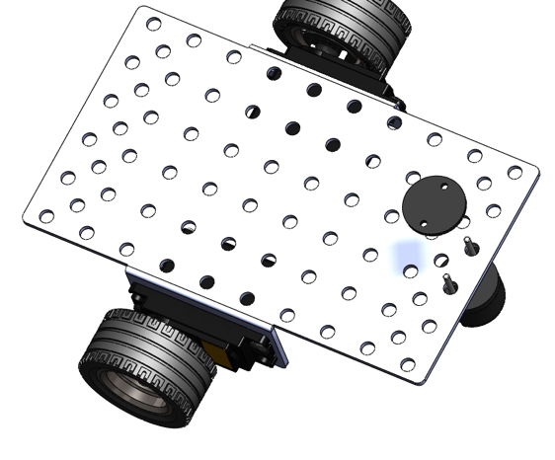
Take the thin washer from “Pololu Ball Caster” bag and place over bolts.

Slide 36
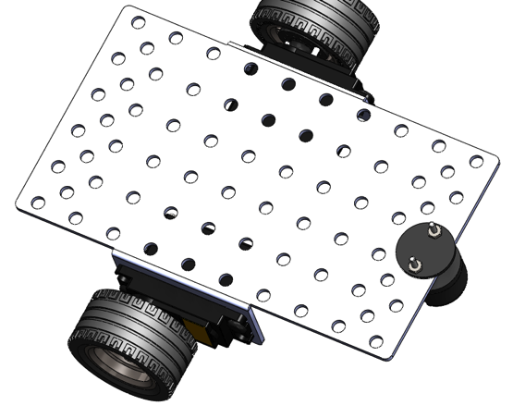
Take nuts out of “Pololu Ball Caster” bag and secure caster assembly to the chassis. Tighten with the screwdriver from the other side. Pop the ball back into the caster.

Slide 37
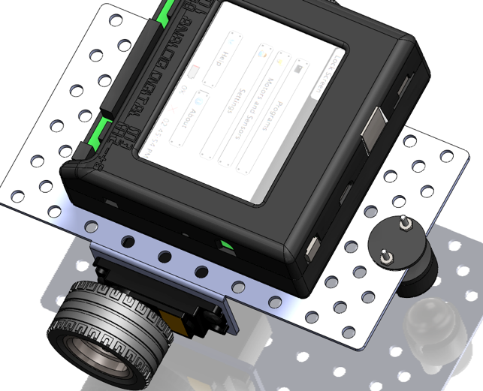
Option one- Set your KIPR Link onto the chassis in the orientation shown.
Power switch located opposite from the ball bearing caster. Leave three holes uncovered on the chassis on the caster side.
There are two options for attaching your KIPR Link to the chassis. Option one attaches with push rivets and option two (slides at the end of the presentation) allows you to simply set your KIPR Link on the chassis so that you can quickly change out the KIPR Link if you need to.

Slide 38
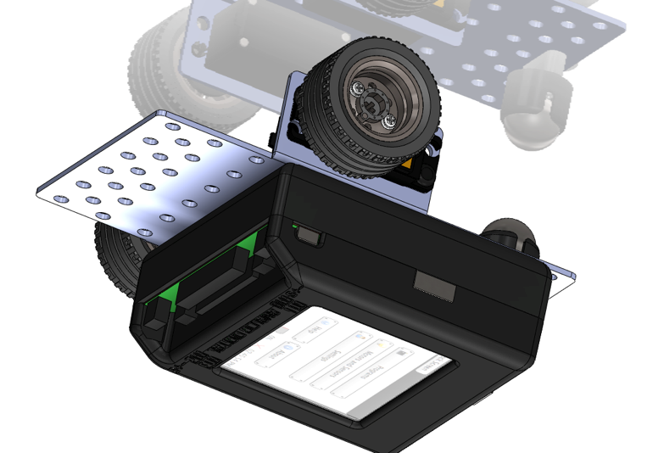
CAREFULLY turn the chassis/KIPR Link upside down. REMEMBER it is NOT attached and will fall. You can hold it with your hand until we attach it in the next step or CAREFULLY set it upside down on the table.

Slide 39
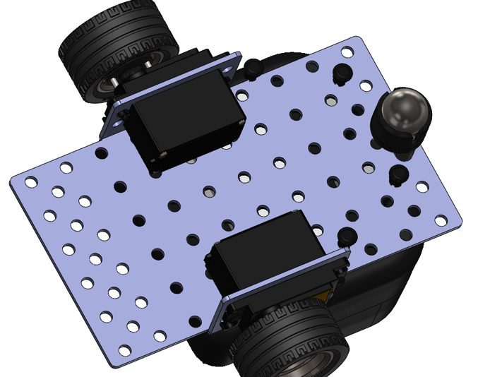
Take Four (4) plastic pop rivets, identical to the ones you used to attach the motors to the chassis and attach the KIPR Link to the chassis by lining up the holes (as shown) and pushing them in until they lock. Once you have the KIPR Link locked into place you can turn your robot over and let it rest on the wheels and caster.

Slide 40

Take a KMP (KIPR Metal Part) Angle Bracket piece out of the “KIPR Metal Pieces Box”. You can identify it by the hole spacings that look like a smiley face. It is shown here for identification and will be attached soon.

Slide 41

This is to show position only, it will be attached with bolts and nuts in the next slide. NOTICE the alignment on the chassis and the holes in the angle bracket that will be used. IT WILL NOT be straight when properly aligned, but this is okay.

Slide 42

Place two (2) short black bolts as shown. They are in a ziplock bag with wrenches and offsets in the GREEN paper insert labeled “Electronics Kit”. There are 3 lengths of bolts (short, medium and long) and two types of nuts (locking with white nylon and locking with attached lock washer). You will need the locking with lock washer nuts in the next step.

Slide 43

Using the lock nuts attach the angle bracket to the chassis and tighten using the wrench and screwdriver. This is shown upside down for clarity. You do not have to turn your robot upside down to attach the nuts.

Slide 44

Identify your KMP (KIPR Metal Part) Motor Bracket. It is shown here for identification and will be attached in the next slide.

Slide 45


Attach the motor bracket to the chassis using the short bolts and lock washer nuts. Tighten with the wrench and screwdriver.

Slide 46

You will need one (1) servo.
You can distinguish servos from motors by the wiring. Motors have a double grey wire and servos have a triple red, orange, brown wire. You will also need one small round servo horn for the next step.

Slide 47


Pop Rivets
Place the round servo horn onto the servo just like you placed the servo horn onto the motor and secure with the small silver servo horn screw. Tighten with the screwdriver. You can attach the servo horn to the servo before attaching the servo to the servo bracket with two (2) plastic pop rivets. Secure the servo to the mount by pushing the pop rivets in until they snap into place.
Notes:
It’s slightly easier if you put the screw into the motor before you place the motor into the bracket. Attach servo to bracket.

Slide 48

You will need one (1) 11 hole LEGO piece
This will be attached to the servo horn in the next step it is shown here for identification ONLY.

Slide 49

LEGO should be vertical (Not as depicted here)
BEFORE attaching the LEGO to the servo horn, ROTATE the servo horn clockwise (turn towards KIPR Link) until it stops. Then ORIENT the LEGO piece so that it is pointing straight up/VERTICAL(not shown in this picture).
You will need two (2) of the longer silver screws found in the servo bags and using the screwdriver attach the 11 hole LEGO piece to the servo horn. MAKE SURE the LEGO piece is vertical.
Notes:
Again, it helps to widen the holes first, and to temporarily put a light colored paper between the horn and the motor to help align the holes.

Slide 50


OPTION 2
Attach the LEGO pieces to the chassis as shown
Option 2 uses ¾ friction pins and the Lego pieces. Remember this just keeps the KIPR Link from sliding off the chassis and allows easy change of the KIPR Link, BUT the KIPR Link will fall off if it is turned upside down.

Slide 51

Get to know your controller
KIPR Link Basic Features
GNU/Linux based operating system
Open-source robot control software
Integrated color vision system
800MHz ARMv5te processor
Spartan-6 FPGA
Integrated battery and charge system
Internal speaker
320 x 240 color touch screen
Input and Output
1 - 3 axis 10-bit accelerometer (software selectable 2/4/8g)
8 – Digital I/O ports (hardware selectable 3.3V or 5V)
8 - 3.3V (5V tolerant) 10-bit analog input ports
4 - Servo motor ports
4 - PID motors ports with full 10-bit back EMF and PID motor control
1 - 3.3V (5V tolerant) TTL serial port
2 - USB A host ports for connecting devices
1 - Micro USB port to connect to your computer
1 - Physical button
1 - IR emitter
1 - IR receiver
1 - HDMI port
You have the KIPR LINK Manual on the flash drive provided to you

Slide 52
Charging the KIPR Link Controller
For charging the KIPR Link, use only the power supply which came with your Link
Damage to the Link from using the wrong charger is easily detected and will void your warranty!
The KIPR Link power pack is a lithium polymer battery so the rules for charging a lithium battery for any electronic device apply
Only an adult should charge the unit
You should NOT leave the unit unattended while charging
Charge away from any flammable materials and in a cool, open area

Slide 53
Learning about the Link Controller
Goals
To be able to identify all of the ports on the link controller and what they are used for
To be able to identify the buttons and their use
To understand the proper charging procedure (only an adult, only under supervision at all times, not around water or flammable materials)
Preparation
Have a link controller available for students to examine along with a projection of the resource slide with pictures of the controller OR give students a printed sheet of the resource slide
Print the table in the resources for students to use to identify and then learn the use of the items
Have the students use their science/engineering/robotics notebook to make
their own checklist/table to account for all ports and switches
Resources
The KIPR Link Manual (on your flash drive)

Slide 54




KEY
Color touch screen
HDMI port speaker side button
TTL serial USB 2 USB Power
8 analog 8 digital
sensor ports sensor ports
2 servo
motor ports
2 servo
motor ports
power switch IR Sensor
2 motor ports
2 motor ports

Slide 55
KEY
1 | A | HDMI Port | J | Where you plug in SERVO motors
2 | B | Speaker | K | Where you plug in motors
3 | C | Side Button | M | Where you plug in digital sensors
4 | D | TTL Serial | L | Where you plug in analog sensors
5 | E | USB 2 | N | Where you can interact with the controller
6 | F | USB | H | Used to turn the Link on and off
7 | G | Power | B | Used to play sounds
8 | H | Power Switch | I | Used to emit and receive Infrared
9 | I | IR Sensor | E | Used to download programs from the computer to the link
10, 15 | J | Servo Ports | D | Used to connect to the iRobot Create Platform
11, 14 | K | Motor Ports | A | Used to connect to a display
12 | L | Analog Sensor Ports | G | Used to charge the Link FOLLOW PROPER PROCEDURES
13 | M | Digital Sensor Ports | C | Used for human input (used in porgramming)
16 | N | Color Touch Screen | F | Used for flash drives, keyboards, mouse

Slide 56
#1 #2 #3
#16
#4 #5 #6 #7
#10
#12 #13
#15
#11
#8 #9
#14

Slide 57
Get to know your KIPR Link
Item # goes here
Letter in front of Item
 | A | HDMI Port |  | Where you plug in SERVO motors
 | B | Speaker |  | Where you plug in motors
 | C | Side Button |  | Where you plug in digital sensors
 | D | TTL Serial |  | Where you plug in analog sensors
 | E | USB 2 |  | Where you can interact with the controller
 | F | USB |  | Used to turn the Link on and off
 | G | Power |  | Used to play sounds
 | H | Power Switch |  | Used to emit and receive Infrared
 | I | IR Sensor |  | Used to download programs from the computer to the link
 | J | Servo Ports |  | Used to connect to the iRobot Create Platform
 | K | Motor Ports |  | Used to connect to a display
 | L | Analog Sensor Ports |  | Used to charge the Link FOLLOW PROPER PROCEDURES
 | M | Digital Sensor Ports |  | Used for human input (used in porgramming)
 | N | Color Touch Screen |  | Used for flash drives, keyboards, mouse

Slide 58
Know your Robot Controller
Using a Link controller OR the print out OR a Link controller projected on the screen use the table provided by your teacher to identify the items by number
Now match the items with their proper use (use the letter in front of the item)

Slide 59
Be the Robot Activity
Goals
To help students understand the importance of specific directions
To facilitate the student’s understanding of pre-thinking the logic of providing directions to the “robot”
Preparation
Set up the room so that a blindfolded “robot” student can move around with out getting hurt.
Arrange the room so that there are some open areas and a few obstacles.
Activity
Explain the task to be completed by the blindfolded human robot (must start here go around the desk and stop at the white board, etc.).
Make sure they must go around some obstacles, make a few turns and end at a specific location, maybe back to where they started
Blindfold the student robot or simply have the student close their eyes. Put them in the “starting box” and have the other students provide directions to complete the task
One student at a time should give only 1 direction at a time. For example; move forward 3 steps, stop, turn right, stop
Document the instructions the students provide to the “student robot”
Use the documented instructions to write out the steps
Using documented steps, they can analyze it for success one step at a time. This is a great whole group activity
Complete the Flow Chart activity, which introduces the concept of flow
charts instead of written steps

Slide 60
Be the Robot Activity
Your teacher will explain the task that your human “robot” must complete.
Select a volunteer student to be the human “robot”.
Select students who will call out instructions to the robot.
Only one student at a time can provide directions, make sure to take turns in the proper order
Only one direction at a time may be provided to the “robot”
Run the “robot” by providing the directions and see how successful you were at controlling the robot.
Discuss was it easy or hard to make the robot complete the task
Could you do this with less instructions?
After brainstorming ideas to make the instructions better, write the steps out one at a time and in the proper order on the whiteboard, chalkboard or in your notebook.
Select another “robot” volunteer and read the written directions one at a time to see if they work any better.
Analyze for improvements in the written instructions and repeat.
Discuss what made for better instructions.
Move on to the next activity, Flowcharts!

Slide 61
Be the Robot Flowchart Activity
Goals
To help students understand how to construct a flowchart
To introduce students to the concept of decision making “logic”
To facilitate the student’s understanding of using flowcharts to pre-think and plan the logic of how they program their robot
To ensure that students can read a flowchart and equate it to actual robot behavior
To ensure that students can look at robot behavior and equate it to a flow chart
Use a flow chart to spot errors in logic (it didn’t work, where is the problem?)
Preparation
Print the flowchart symbol (resource slide).
Cut out the flowchart symbols ahead of time (one set per group or one for the whole class) or print the sheet and have the students cut them out.
A magnet on the back makes them great to use on a whiteboard
You can make some oversized symbols if you plan this as a whole group activity
Activity
Have the students complete the following flowchart activity.
Using the cutouts make a flowchart and have the students draw out what they think the robot will do (pretend the robot leaves a mark on the floor/board with a marker as it moves around).
Using a reference robot path (one is provided in resources), print the sheet for each group or draw it on the board and have the students work backwards creating a
flowchart from the actual path.

Slide 62
START
START
MAKE A DECISION
YES or NO
MAKE A DECISION
YES or NO
STOP
STOP
DO SOMETHING
YES
YES
DO SOMETHING
DO SOMETHING
NO
NO
DO SOMETHING

Slide 63
Create a Flow Chart from the robot’s path
1 foot
1 foot
START
5 feet
3 feet
STOP
2 feet
2 feet
2 feet
8 feet

Slide 64
Create a Flow Chart from the robot’s path (decisions)
WALL
START
STOP

Slide 65
Flow Chart Activity
Programming (telling your robot what to do)
1. Decide what you want the robot to do.
I want the robot to start, move forward and stop before it hits the wall

Slide 66


Programming (telling your robot what to do)
2. Draw a DIAGRAM that shows the steps.
But not just any old DIAGRAM…..

Slide 67

Programming (telling your robot what to do)
Computer Scientists & Engineers use
a diagram of their program called
a FLOWCHART.

Slide 68
Programming (telling your robot what to do)
Notice how they use different SHAPES and COLORS.

Slide 69

Programming (telling your robot what to do)
So that everyone will understand each other’s flow charts everyone uses the same shape and color for certain actions.

Slide 70
Programming (telling your robot what to do)
START
MAKE A DECISION
(YES or NO)
The start and the stop are easy to understand: these are where the instructions “program” starts and stops
STOP
Yellow diamonds are always a choice or decision (you must have at least two choices after a yellow diamond)
DO SOMETHING
What the robot is programmed to do

Slide 71
Programming (telling your robot what to do)
The arrows show the direction or flow of the instructions “program”.
That’s why it is called a flowchart!

Slide 72
Now, cut out your shapes and sort them
START
START
MAKE A DECISION
YES or NO
Is There a Wall?
YES or NO
STOP
STOP
Move Forward 3 feet
YES
YES
DO SOMETHING
Move Backward 3 feet
NO
NO
DO SOMETHING

Slide 73
Programming (telling your robot what to do)
3. Use your cut outs to make a flow chart of a program that:
Has your robot START.
Has your robot move forward 3 feet.
Has your robot STOP.

Slide 74
Programming (telling your robot what to do)
Did you remember the arrows?
Arrows are very important in a FLOWChart…..

Slide 75
Programming (telling your robot what to do)
Starts the program “instructions”…
…then it…
...moves forward 3 feet…
…then it…
…stops the program “instructions”…
START
Move Forward 3 feet
STOP

Slide 76
Programming (telling your robot what to do)
5. Now make a flowchart of a
program that:
Has your robot START.
Has your robot move forward 3
feet.
Has your robot move backward 3 feet.
Has your robot STOP.

Slide 77
Programming (telling your robot what to do)
START
Move Forward 3 feet
Move Backward 3 feet
STOP

Slide 78

Programming (telling your robot what to do)
4. Time to make a decision.
YES or NO?
MAKE A DECISION

Slide 79
Programming (telling your robot what to do)
The decision will change what the robot does.
What do I do?
Is there a wall right in front of you?

Slide 80
START
Now I know what to do?
MOVE FORWARD 3 feet
Is there a wall right in front of you?
If NO
If YES
Notice the 2 choices or options
STOP
Notice that a choice MUST be made

Slide 81
Programming (telling your robot what to do)
6. Now make a flow chart of a program that:
Has your robot START.
Has your robot move forward
3 feet.
Has your robot detect a wall and make a decision. (YES or NO)
Has two choices for your robot.
Has your robot STOP.

Slide 82
START
MOVE FORWARD 3 feet
Is there a wall right in front of you?
If NO
If YES
STOP

Slide 83
Programming (telling your robot what to do)
7. Now make a flowchart of a program of your own choice.
Include at least one decision.

Slide 84
DRAW WHAT YOU THINK THE FLOW CHART WILL MAKE THE ROBOT DO
In your notebook or on the board draw the path you think your robot will follow from the following flow chart.
START
MOVE FORWARD 3 inches
Turn Right
STOP
MOVE FORWARD 3 inches
MOVE FORWARD 3 inches
Turn Right
MOVE FORWARD 3 inches
Turn Right

Slide 85
Did you get a square?

Slide 86
Explain what the robot is doing

Slide 87


Flowcharts are great for humans, but
?
I don’t understand
?
?
?
Computers don’t understand or speak this type of language so we need to write (program) the instructions in a language that computers can use
Notes:
MAKE IT MAKE A SHAPE

Slide 88
Introduction to Programming Languages
Goals
To help students understand the terms; IDE, compiler, source code and programming language
Preparation
Prepare word/term cards (index cards, etc.) for a word wall (sample in resource slide) or have the students write the terms in their notebooks
Machine Language (what the computers understand- Bytes)
Executes (in terms of a computer running or executing the instructions)
Source Code (name for code written in programming language)
Compiled (translated from a programming language to a machine language)
Programming Language (Language humans understand that can be turned into machine language)
C, C++, Java, Python (names of programming languages)
Activity
After reviewing and discussing the slides have the students generate and agree on the definitions/uses of the term
Word Wall
Write in their notebooks
With a partner match up the word card with the correct definition card

Slide 89
Machine Language
Programming
Language
The language (bytes) that computers understand
Executes
C, C++, Java, Python
A computer _______ a program when it runs the program
Source Code
Translated from a programming language to a machine language
Language humans can understand that can be turned into machine language
Compiled
Name for code written in a programming language
Strange names of some of the often used programming languages

Slide 90


Programming Languages
Bla, Bla, Bla, Bla,
?
Computers only understand machine language (stream of bytes), which they can then read and execute (run).
Humans on the other hand, don’t do well with machine language.

Slide 91
Why not use an interpreter?
Programming Language
Compiler
Machine Language
Translates
Humans have created languages with funny names like; C, C++, JAVA, Python, that allow them to write “source code” which they can understand and edit.
This source code is then compiled (translated) into machine language that the computer can understand and execute (run).

Slide 92
Programming Vocabulary Activity
Using the cards you cut out or your teacher provided for you match up the terms with their definition

Slide 93
Introduction to Programming Languages
Goals
To help students understand that languages have rules/conventions you must follow
Sentences start with a capital and end with a punctuation mark, etc.
Understand how programs such as Microsoft Word or other applications help you follow the rules/conventions of a program
Understand that the KISS IDE (Integrated Development Environment) is like a word processing program that helps them follow the rules/conventions while they write their source code
New Vocabulary word is Debug, meaning checking your program for errors and fixing them much like when Microsoft Word underlines misspelled words or grammatical errors
Activity
Have students list things the computer program/application Microsoft Word helps them with when they are writing.
In their notebooks
Whole class activity on the board

Slide 94
Rules you use when writing
List as many rules as you can think of you must follow when writing a report in school
Once you have everything listed go to the next slide and add anything you didn’t have on your list

Slide 95
Rules/Conventions when writing
These are things that are always done in a language.
For example:
When writing a sentence you always start with a capital letter
Complete sentences should end with a period.
Spaces are used to create paragraphs, which are used to separate out ideas
The order of words make a difference
The ran horse slowly as compared to the horse ran slowly
Math has conventions as well
Order of operations (1+2) X 4

Slide 96
Programming Languages
Computer languages are like any other language: they take a little time and effort to learn all of the rules/conventions.
The more you practice the better you will get!

Slide 97
How does the Microsoft Word program help? Activity
Have you ever used a word processing program such as Microsoft Word?
What does it help you do when you are typing something like a report?
List all of the things the program helps you with

Slide 98

Word Processing programs highlight possible errors

Slide 99
Integrated Development Environments (IDE) help you with the rules/conventions of programming languages
These are software applications (Apps) that make it easy for you to write and edit your source code, debug it (look for mistakes) and compile (translate) it.
This is kind of like a word processing program that lets you write text, format it, spell check, etc.
Notes:
WHAT OTHER APPS THAT HELP YOU

Slide 100

KISS IDE
To make it easier for you to learn and use the programming language we have the KISS IDE, which will allow you to develop source code with the C programming language

Slide 101
Introduction to a simple C program
Goals
To help students understand the basic components of a C program
Main program, function, return, curly braces, terminating statements (;) and comments
To help students understand what a function is
Preparation
Students need to be able to see a program
Project the “Hello World” onto a white board or screen so the whole class can see it.
Print out the C program “Hello World” so that each group/student has one (resource on following slide).
You can have them open the KISS IDE and select the “Hello World” template on their computer (instructions on starting KISS IDE in resources).
Print out or project a more complicated program and have students find the main function, curly braces, semicolons and the return.
You can use vocabulary cards for the new vocabulary words
Activity
Using either the print out, projection or actual KISS IDE on a computer
Run through the program slides and have students identify the different parts of the program (they can circle them on a print out, point to them, etc.) on the simple “Hello World” and the more complicated program as well
Students can draw a flow chart for each program

Slide 102

Make a “robot code” folder on your desktop
To help you keep track of the programs you will be writing, you need to make a folder on your computer’s desktop named “Robot Code”
Right click on the desktop and select new folder
Name it “Robot Code”

Slide 103


Connect the Link to your computer
Using the USB cable connect to the Link (micro usb port)
Turn the Link on with the black switch on the side

Slide 104



Launch the KISS IDE
Start the KISS IDE by clicking on its icon to get the welcome screen
If it is already open, select the New Project tab.
Click on the “New Project” icon
You will have to name your project

Slide 105
Name Your Project
Name your new project (remember you will have a lot of student’s projects- maybe use their first name followed by the challenge #)
Use the default Start with a new file (created in next step)
Use the Browse button to save the project into your “Robot Code” folder on your desktop
1
3
2

Slide 106

Add a new file
You need to name your new file (use something descriptive, in this case ”First Program”)
You must select a file template to use- UNDER C Files highlight Hello World! (this is the template we will always use)
Click OK
1
3
Notice the project “Steve First Program” now appears on the side bar
2

Slide 107


Compiling Your First Program
The “Hello, World” template will now appear
To run the program, you must Compile it
(The compile button sends the program to your
target to be compiled)
A Target Selection window will appear
Select the usb target (this is your robot)

Slide 108

You will see the Compile Succeeded! message

Slide 109

The C Template: Hello, World!
We will use this template every time and simply delete out what we don’t want and add what we want
You can click and hit return to add more lines. You can also use copy and paste

Slide 110


Slide 111
Computers read a program just like you read a book, they start at the top and go to the bottom. Computers read incredibly fast- 800 MILLION lines per second!
int main()
{
return 0;
}
START
Return 0
STOP

Slide 112
int main()
{
printf("Hello, World!\n"); //print Hello World
return 0;
}
int main()
{
printf("Hello, World!\n"); //print Hello World
return 0;
}
int main()
{
printf("Hello, World!\n"); //print Hello World
return 0;
}

Slide 113
Programming Languages have Rules/Conventions as well, let’s look at a simple C (programming language) program
This is the main function and where a program starts executing. ALL C programs must have a main() function.
A function specifies what is to be done. It is like a title to a book of instructions.
int main()
{
return 0;
}
START
Return 0
STOP

Slide 114
Functions
Function- a function in a program specifies what is to be done. It is like a title to a book of instructions.
A clean_house() function could mean vacuum, dust, mop, change the linens, wash the windows etc... all the commands specified in the function are executed.

Slide 115
Looking at a program
return type name argument list
int main()
{
return 0;
}
Programs should always return something. In this case the int stands for integer (whole number)
The name is descriptive so you can easily see what it is.
In between the argument list you can specify details.
In this case it is not specifying anything to be returned.

Slide 116
Looking at a program
START
Start
int main()
{
return 0;
}
Return 0
Stop
STOP
The curly braces organize everything you want the program to do (execute) when the computer comes to the last curly brace it will end the main program.

Slide 117
Looking at a program
START
int main()
{
printf("Hello, World!\n");
return 0;
}
Print “Hello World”
Return 0
STOP
This is the code and specifies the things (functions) you want the program to execute.

Slide 118
Looking at a program
START
int main()
{
printf("Hello, World!\n");
return 0;
}
Print “Hello World”
Return 0
STOP
Notice the program returns a value even though it is 0.

Slide 119
Looking at a program
START
int main()
{
printf("Hello, World!\n");
return 0;
}
Print “Hello World”
Return 0
STOP
When the program is executing the semicolon terminates the code and says go to the next line. Without it, the code will not compile (be translated so the computer can understand it).

Slide 120

The KISS IDE highlights parts of a program to make it easier to read
By default, the KISS IDE colors your code and adds line numbers
Comments appear in green
Key words appear in bold blue
Text strings appear in red
Numbers appear in aqua
int main()
{
printf("Hello, World!\n");
return 0;
}

Slide 121
Functions
Goals
To help students understand functions and how to access the KISS IDE Function Library
To reinforce the learning of basic functions they will use when programming their robots
Function has descriptive_name (argument); (terminating statement)
Preparation
Print cards (found in resource slide) that students can have with them when they start programming their robots
Have the KISS IDE open and running on a master computer everyone can see OR better yet open on each of the student’s computers
Activity
Have the student open the KISS IDE (instruction in resource slides)
Access the KISS IDE User Manual
Scroll through the function libraries (The libraries also contain functions for the iRobot Create Platform in addition to the DemoBot platform these exercises use)
Have students cut out the function cards they will use when programming their robots

Slide 122
Background Information Why use C?
C is a high level programming language developed to support the Unix operating system
The KIPR Link controller utilizes a version of Unix called Linux
C is the most widely used language for systems programming
Botball robots need to be programmed at the systems level to use the features of the KIPR Link
For the Link controller, the KISS IDE (Integrated Development Environment) provides a user friendly interface to develop programs in C, C++, Java and Python
These activities focus on C

Slide 123
Connect the Link to your computer
Using the USB cable connect to the Link (micro usb port)
Turn the Link on with the black switch on the side

Slide 124
Launch the KISS IDE
Start the KISS IDE by clicking on its icon to get the welcome screen
If it is already open, select the New Project tab.
Click on the “New Project” icon
You will have to name your project

Slide 125
Name Your Project
Name your new project (remember you will have a lot of student’s projects- maybe use their first name followed by the challenge #)
Use the default Start with a new file (created in next step)
Use the Browse button to save the project into your “Robot Code” folder on your desktop
1
3
2

Slide 126
Add a new file
You need to name your new file (use something descriptive, in this case ”First Program”)
You must select a file template to use- UNDER C Files highlight Hello World! (this is the template we will always use)
Click OK
1
3
Notice the project “Steve First Program” now appears on the side bar
2

Slide 127

The C Template: Hello, World!

Slide 128
Functions
A function is like a title to an instruction book. When you call the function it does all of the commands in the book.
A clean_house() function could mean vacuum, dust, mop, change the linens, wash the windows, etc… all the commands specified in the function are executed.
The KISS IDE contains a large library of functions you can use to program your robots.

Slide 129

Function Examples
I wonder if that controls motors?
Name
Arguments
Terminating Statement
motor(0, 100);
Turns on motor in port 0 at 100% power
digital(8);
Returns the values from the sensor plugged into the #8 digital port. It will be a number, either 1 or 0 (1 = yes/true and 0 = no/false).
analog10(3);
Returns the value of the analog sensor plugged into analog port #3 (analog values are between 0 and 1024).

Slide 130
Where Can I Get Help?
The KISS IDE has an extensive User Manual including a brief C tutorial
The User Manual is found under the Help menu
When using C for Botball, the User Manual is the primary document to consult
The User Manual covers the library of functions for accessing the features of the Link controller and for controlling a Create module
The Sensors and Motors Manual provides additional information about the sensors and motors used with the KIPR Link
Accessed from the Team Home Base or on teacher’s flash drive

Slide 131


Getting Help With the KISS IDE open simply select the help tab then documentation

Slide 132

Select KIPR Link C Standard Library

Slide 133

KISS IDE User Manual
Select KIPR Link Library

Slide 134

KIPR LINK Library

Slide 135
Hint
Until you are familiar with the functions that you will be using while programming , use your “cheat sheet” for easy reference. Copy and paste is also very helpful.
motor (port#, % power); Turns motor on at % power specified
ao (); All off, turns all motor ports off
digital (port #) ; Refers to a specific digital port #
analog 10 (port#) ; Refers to a specific analog port #
mrp (port#, velocity, position) ; Move to relative position (# ticks)
wait_for_light (port#) ; Robot waits for light in specified port 3 before starting
shut_down-in (time in seconds); Shuts down all motors at specified time
msleep (# miliseconds) ; Program waits specified number of milliseconds
enable_servos () ; Turns servo ports on
set_servo_position (port#, position); Moves servo in specified port to a set position

Slide 136
Writing Programs- Screen Display
Goals
To help students understand how to use the KISS IDE to write a program
To understand how to compile, download and run the program on their Link controller
To understand how to use the print function to print things to the screen
To understand how to use the msleep function to give commands time to execute
Preparation
Students will need computers with KISS IDE installed and access to a Link controller
Activity
Have the student open the KISS IDE (instruction in resource slides)
Follow the slides to write program to the screen display

Slide 137
First C Program Programming Basics and Screen Output

Slide 138
Connect the Link to your computer
Using the USB cable connect to the Link (micro usb port)
Turn the Link on with the black switch on the side

Slide 139
Launch the KISS IDE
Start the KISS IDE by clicking on its icon to get the welcome screen
If it is already open, select the New Project tab.
Click on the “New Project” icon
You will have to name your project

Slide 140
Name Your Project
Name your new project (remember you will have a lot of student’s projects- maybe use their first name followed by the challenge #)
Use the default Start with a new file (created in next step)
Use the Browse button to save the project into your “Robot Code” folder on your desktop
1
3
2

Slide 141
Add a new file
You need to name your new file (use something descriptive, in this case ”First Program”)
You must select a file template to use- UNDER C Files highlight Hello World! (this is the template we will always use)
Click OK
1
3
Notice the project “Steve First Program” now appears on the side bar
2

Slide 142

Writing Your First Program
The “Hello, World” template will now appear
To run the program, you must Compile it
(The compile button sends the program to your
target to be compiled)
A Target Selection window will appear
Select the usb target (this is your robot)

Slide 143
Writing Your First Program
You will see the Compile Succeeded! message

Slide 144
Activity 1 (Task Design) Programming Basics and Screen Output
Break the objectives down into separate tasks and think about how each might be accomplished; for example, the larger task might be developing a program to operate a robot's claw, which has tasks within for making the claw open or close.
Since this is our first example, the task is pretty simple:
Display the text "Hello World!" on the Link screen.

Slide 145
Pseudocode and Comments
Pseudocode- write out what you want the program to do
pseudocode (this means "false code") to help write the real code…
// 1. Display "Hello World!" on the screen.
Comment your code (pseudocode makes great comments) - your comments show what you expect your program to cause your robot to do, but that might not be what it will actually do!

Slide 146
Comments
Comments as psuedocode are helpful and they help you keep track of what is going on in the program.
You can make a flow chart and then convert it to psuedocode.
The computer will not execute the comment, but you can see it.
There are 2 ways to comment C programs // and /* */
// is a comment for rest of line
or
/* is a comment that goes from
the initial slash-star until
the first star-slash */

Slide 147
The Program Explained (it illustrates most C syntax)
return type name argument list
int main()
{
//Display Hello World! On screen
printf("Hello, World!\n");
return 0;
}
Comment
Function
Syntax is important! Notice the quotation marks and notice the \n at the end?

Slide 148
Blocks of Code
int main()
{
//Display Hello World! On screen
printf("Hello, World!\n");
return 0;
}
Comment

Slide 149
Terminating Statements
int main()
{
//Display Hello World! On screen
printf("Hello, World!\n");
return 0;
}
START
Print “Hello World”
Return 0
STOP

Slide 150

Compile your program
Compile your program using the compile tab

Slide 151


Running your program on the Link
Select the program button that will take you to a list of programs currently on the Link controller.

Slide 152

Running your program on the Link
Highlight the program you want to run, in this case, “Hello World”, and then push the “Run” button

Slide 153

Running your program on the Link
Pressing the OK button will now run the program
You should see “Hello, World !” displayed on the screen

Slide 154
Activity 2 Programming Basics and Screen Output
Write a program for the KIPR Link that displays "Hello World!” and then displays your “name”, compile, download and run it on your Link.
Psuedocode (Task Analysis)
// 1. Display "Hello World!" on the screen.
printf (“Hello World\n”);
// 2. Display your name on the screen.
printf (“ Botguy\n”);

Slide 155
What did you notice when you ran the program?
The controller reads the code and goes to the next line faster than a blink of your eye.
At 800MHz the controller is executing ~800 Million lines of code/second!
To control a robot you must give the function (command) TIME to run on the robot.

Slide 156
msleep()
Like printf(), msleep() is a built-in (library) function.
msleep(3000) causes the KIPR Link to pause for 3 seconds (the m stands for milliseconds or 1/1000 of a second).
Example:
printf("slow");
msleep(3000);
printf("reader\n");

Slide 157
Activity 3 Programming Basics and Screen Output
Write a program for the KIPR Link that displays "Hello World!" to the screen, delays two seconds, and then displays your name on the screen.
Psuedocode (Task Analysis)
// 1. Display "Hello World!" on the screen.
// 2. Pause for 2 seconds.
// 3. Display your name on the screen.

Slide 158
Activity 3 Solution Programming Basics and Screen Output
#/*************************************************************
********* Activity 2 *************************************************************/
int main()
{
// 1. Display "Hello World!" on the screen
printf("Hello World!\n");
// 2. Delay for 2 seconds
msleep(2000); //2000ms = 2sec
// 3. Display your name to the screen
printf("Botguy.\n");
return 0;
}
START
Print “Hello World”
Pause for 2 seconds
Print “your name”
Return 0
STOP

Slide 159
Debugging
Goals
To help students understand how to use the KISS IDE to debug a program
Preparation
Students will need computers with KISS IDE installed and access to a Link controller
Activity
Have the student make intentional errors to learn how to debug their program

Slide 160
Run the Hello World program on the Link again, but this time …
You can download it again to your Link OR simply hit the “BACK” Button on the touch screen and reselect the “Hello World” Program
The Link will keep the program you run on it in its program files
Make sure you name programs so you know which ones to select
Leave off the terminating semicolon and see what happens
int main()
{
printf("Hello, World!\n");
return 0;
}
\n doesn't show up on the printed output it simply tells the display to print to a new line similar to the return key on a keyboard

Slide 161

Compile Failed “Debugging”
Example “Error Message”
Compile Failed message at the bottom of the window
line #: col # (on or before)
“expected a ;”
When there is an error, you can ignore the first error line (“in function ‘main’”) and then start reading to see what the error is. If you have a lot of errors start fixing them from the top going down. Fix one or two and recompile.

Slide 162
Activity Extensions Programming Basics and Screen Output
Try adding more printf() statements to your program (pay close attention to the syntax, particularly the terminating semi-colon needed by each statement)
Have the program print out a haiku about robotics
What does \n and \t do?
What happens if you leave off the quotation marks?
Try adding the command display_clear();
Can you print out more lines than can show on the screen at one time?
What happens when the screen fills up?

Slide 163
Moving your robot with the motor() function
Goals
To reinforce the concept of a function
To use the motor function to move their robot
Preparation
You will need the DemoBot built and ready to go
You will need computers with the KISS IDE
You will need the USB download cable
Activity
Follow the slides to make the robot move

Slide 164
Activity 3 Lets make a robot move!
Use the provided robot or build your robot using the Demo Robot building guide.

Slide 165
Connect the Link to your computer
Using the USB cable connect to the Link (micro usb port)
Turn the Link on with the black switch on the side

Slide 166
Launch the KISS IDE
Start the KISS IDE by clicking on its icon to get the welcome screen
If it is already open, select the New Project tab.
Click on the “New Project” icon
You will have to name your project

Slide 167
Name Your Project
Name your new project (remember you will have a lot of student’s projects- maybe use their first name followed by the challenge #)
Use the default Start with a new file (created in next step)
Use the Browse button to save the project into your “Robot Code” folder on your desktop
1
3
2

Slide 168
Add a new file
You need to name your new file (use something descriptive, in this case ”First Program”)
You must select a file template to use- UNDER C Files highlight Hello World! (this is the template we will always use)
Click OK
1
3
Notice the project “Steve First Program” now appears on the side bar
2

Slide 169
The C Template: Hello, World!
We will use this template every time and simply delete out what we don’t want and add what we want

Slide 170
Check your Robot’s Motor Ports
To program your robot, you need to know what motor ports your motors are plugged into
* REMEMBER computer scientists start counting at 0 so the motor ports are 0, 1, 2 and 3

Slide 171

KIPR Link Motor Ports
Motor ports 0 (DemoBot), 1, 2, and 3 (DemoBot)

Slide 172



Plugging in Motors
Motors are the ones with two-prong plugs with 2 gray wires
The KIPR Link has 4 drive motor ports numbered 0 & 1 on the left and 2 & 3 on the right
When a port is powered it has a light that glows green for one direction and red for the other
Plug orientation order determines motor direction, but by convention, green is forward and red reverse
motor port 3
Drive motors have a 2 prong plug
motor port 2
Notes:
172
Since the DC drive motors are modified servo motors, it is easy to use one when the other was intended in building a robot. Just remember the DC drive motors are the ones with a two wire cable terminating in a two prong plug and the servo motors are the ones with a cable having three colored wires terminated by a three socket plug.
The drive motor plug when plugged in straddles the middle socket of each motor port (the middle socket is not connected).

Slide 173

Plugged in motors
Motor Ports 0 and 3

Slide 174
Motor Direction
Motors have grey wires with 2 prongs on the plug
There is no left or right or colored wire
You can plug these in two different ways
Motors rotate in the direction that the electricity (electrons) move through them. One direction is clockwise and the other direction is counterclockwise
*You want your motors going in the same direction,
otherwise your robot will go in circles!
1
2
2
1

Slide 175



Motor Port & Direction Check
There is an easy way to check this!
Manually rotate the tire and you will see a LED light up by the motor port (port # is labeled on the board)
If the LED is green it is going forward
If the LED is red it is going backwards
Using the manual tire rotation trick, check the direction and port #’s of your motors
If one is red and the other green turn one motor plug 180° and plug it back in
The lights should both be green if the robot is moving forward

Slide 176
Functions to Use
There are several functions for motors, we will begin with motor()
Computer scientists start counting at 0 NOT 1
motor(0, 100);
Turns on motor port 0 at 100% power. You can select any power level up to 100%
msleep(XXXX);
//Pause
ao();
//All Off
A positive number should drive the motors forward. If not, switch the motor plug 180°.
A negative number will drive the robot in reverse. If the motors are set up opposite one another the robot will go in a circle.

Slide 177
Explain using comments
You can use a flow chart and then translate that into comments.
Using //comments as pseudocode is a great way to start.
If you forget which functions to use, look at your cheat sheet.

Slide 178
Lets make a robot move!
Write a program for your robot to move forward for 2 seconds and then stop.
Use motor ports 0 and 3
Check the LEDs to make sure you are in the right ports and going in the right direction
Psuedocode (Task Analysis)
// 1. Drive forward
// 2. Pause program for 2 seconds to give the motors time to move
// 3. Turn everything off
START
Drive Forward 2 sec
Turn Motors off
STOP

Slide 179
Lets make a robot move!
Now that you have written your program, you must Compile it
(The compile button sends the program to your
target to be compiled)
A Target Selection window will appear
Select the usb target (this is your robot)

Slide 180
Running your program on the Link
Select the program button that will take you to a list of programs currently on the Link controller.

Slide 181
Running your program on the Link
Highlight the program you want to run, in this case, “Hello World”, and then push the “Run” button

Slide 182
Activity 3 Solution
#/*************************************************************
********* Activity 3 *************************************************************/
int main()
{
// 1. Drive Forward
motor(0,80); //Motor in port 0 at 80%
motor(3,80); //Motor in port 3 at 80%
// 2. Give time for the motors to move
msleep(2000);
// 3. Turn everything off
ao();
return 0;
}
Notice the motor functions are commented
Positive (+) numbers should move the motors in a clockwise direction (forward). If not, Reverse the motor plug 180° where it plugs into the controller. If your robot goes in a circle one motor is either not moving (check the plug) or they are moving in opposite directions.

Slide 183
Robot Driving Hints
Remember your # line, positive numbers go forward and negative numbers go backwards.
Driving Straight- it is not easy to drive a robot in a straight line.
Motors are not exactly the same
The tires may not be aligned well
One tire has more resistance, etc.
You can adjust this by slowing down and speeding up the motors.
Making Turns
Have one wheel go faster or slower than the other
Have one wheel move while the other one is stopped (friction is less of a factor when both wheels are moving)
Have one wheel move forward while the other is moving backwards
Reverse
Forward
-5 -4 -3 -2 -1 0 1 2 3 4 5

Slide 184


LET’S MOVE! Materials/Supplies
You need a surface to run the robot on
YOU CAN BUY VINYL SURFACES FOR THIS CURRICULUM
http://botballstore.org/product/elementary-botball-challenge-surfaces
Use the floor, desktop (watch for falling robots), a piece of white or light colored foam or poster board or a vinyl or paper mat as a robot testing track
You need an area marked as the starting line (a piece of black tape works well or you can mark it with a black marker)
You need an object to navigate to
Can of soda, foam block, whiteboard eraser, etc. will work
A measuring device and a timer will be useful
Soda Can
Starting line (Tape/Marker)

Slide 185
LET’S MOVE! Activity/mini contests
Using the simple motor function motor(); and msleep(); you can have the students work on fun challenges.
These activities can all be completed using hard coding (“dead reckoning”) and simple motor control functions without the use of any sensors. This is a good place to start and will teach the students how hard it is to be consistent using dead reckoning.
This is a good time to bring up controlling variables when they set up their robot- is it the same every time? How could you make it the same (using a jig or ruler to control how they set it at the starting line)
Once they have the skills down of forward, backwards, stop, turn then we can move on and start adding sensors and decision making into the programs.

Slide 186
Touch the Can
Robots must start on or behind the starting mark and move to the object with the goal of touching the object in the shortest amount of time
Extensions
Move the can to various distances
Make the object smaller and harder to navigate to
Math- have them measure the distance to the object and time the robot and then calculate rate/speed
Speed = Distance/Time
Starting line
Soda Can
Starting line
Soda Can

Slide 187
Closest to the Can
Robots must start on or behind the starting mark and move to the object with the goal of stopping as close to the can as possible without touching it.
If they touch the can they must start over at the starting line
Use rulers to measure the distance stopped from the can- make a data table
You can use a sheet of paper passed between the robot and can to determine if it is touching
You can limit the number of attempts and take the best run or have them average several runs or add the distances together for a grand total
Move the can to various distances and locations
Starting line
Starting line
Soda Can
Soda Can

Slide 188
Closest to/touch the Can and “Go Home”
A variation on touch the can and closest to the can.
After stopping closest/touching the can, back the robot up until touching the starting line
Move the can to various distances
Starting line
Soda Can
Starting line
Soda Can
Starting line
Soda Can

Slide 189
Circle the Can and “Go Home”
Brings in the concept of turning
If you touch the can you must start over
The quickest trip is the winner
Move the can to various distances
Make them go clockwise and then counter clockwise
Starting line
Soda Can

Slide 190
Circle the Can(s) and “Go Home”
Variation on Circle the Can
Have them make a figure 8 around two objects
Barrel Race (have them go around three cans)
Starting line
Starting line
Soda Can
Soda Can

Slide 191
Park in the Garage
Robots must start on or behind the starting mark and park in the garage (box or tape outline on board)
Start with the garage straight across from the starting line
Garage can be roomy and then make it a tight fit
If they touch the garage they must start over at the starting line
Move the garage to various distances and locations
Starting line
Starting line
Garage
Garage

Slide 192
Park in the Garage and Miss the Bicycle
“Park in the Garage” variation
Place an object(s) between the starting line and garage
Starting line
Garage
Starting line
Garage

Slide 193
Walk the Line
Brings in the concept of driving in a straight line
Robot must move without touching the line (easiest to hardest below)
You can use one line and have the robot move down the side without touching it
Make this a time trial-quickest time without touching (faster is harder to control)
You can make a lane and have the robot drive down it without touching either side.
Increase difficulty by making the lane narrower
You can use one line and have the robot straddle it with the goal of running the full length without either wheel touching the line

Slide 194
Variations on Walk the Line
Same as before only have them stop and go backwards without touching the line as well
Add a starting line to begin and a finish line the robot must touch before backing up

Slide 195
Variations on Walk the Line- Jousting!
Robots on opposite sides of the line move towards each other and try to knock object off of other robot
Use whatever object is handy
Engineering Point-
Have the students engineer how they attach their lance (new unsharpened pencils work well) to their robot

Slide 196
Race Track
Brings in the concept of controlled driving
Robot must move within the lane completing the course
Make this a time trial the fastest to complete the course with no errors
If you touch the line then you have to start over and the clock keeps running
You can use a much larger track if desired (taped lanes on the classroom floor work well)
You can use different lane setups
The tighter and more numerous the turns the more difficult it is
Extension- once finished, make them stop and back up all the way to the start

Slide 197
Moving your robot with the other functions
Goals
To use the mav() and mrp() functions to move their robot
Preparation
You will need the DemoBot built and ready to go
You will need computers with the KISS IDE
You will need the USB download cable
Activity
Follow the slides to make the robot move using mav() and mrp()

Slide 198
Let’s make a robot move using mav() and mrp()
Use the provided robot or build your robot using the DemoBot building guide.

Slide 199
Connect the Link to your computer
Using the USB cable connect to the Link (micro usb port)
Turn the Link on with the black switch on the side
Notes:
NEEDS TO BE ROBOT

Slide 200
Launch the KISS IDE
Start the KISS IDE by clicking on its icon to get the welcome screen
If it is already open, select the New Project tab.
Click on the “New Project” icon
You will have to name your project

Slide 201
Name Your Project
Name your new project (remember you will have a lot of student’s projects- maybe use their first name followed by the challenge #)
Use the default Start with a new file (created in next step)
Use the Browse button to save the project into your “Robot Code” folder on your desktop
1
3
2

Slide 202
Add a new file
You need to name your new file (use something descriptive, in this case ”First Program”)
You must select a file template to use- UNDER C Files highlight Hello World! (this is the template we will always use)
Click OK
1
3
Notice the project “Steve First Program” now appears on the side bar
2

Slide 203

The C Template: Hello, World!
We will use this template and remove what we don’t need and add whatever functions we need

Slide 204
Check your Robot’s Motor Ports
To program your robot, you need to know what motor ports your motors are plugged into
* REMEMBER computer scientists start counting at 0 so the motor ports are 0, 1, 2 and 3

Slide 205
KIPR Link Motor Ports
Motor ports 0 (Demobot), 1, 2, and 3 (Demobot)

Slide 206
Plugging in Motors
Motors are the ones with two-prong plugs with 2 gray wires
The KIPR Link has 4 drive motor ports numbered 0 & 1 on the left and 2 & 3 on the right
When a port is powered it has a light that glows green for one direction and red for the other
Plug orientation order determines motor direction, but by convention, green is forward and red reverse
motor port 3
Drive motors have a 2 prong plug
motor port 2
Notes:
206
Since the DC drive motors are modified servo motors, it is easy to use one when the other was intended in building a robot. Just remember the DC drive motors are the ones with a two wire cable terminating in a two prong plug and the servo motors are the ones with a cable having three colored wires terminated by a three socket plug.
The drive motor plug when plugged in straddles the middle socket of each motor port (the middle socket is not connected).

Slide 207
Plugged in motors
Motor Ports 0 and 3

Slide 208
Motor Direction
Motors have grey wires with 2 prongs on the plug
There is no left or right or colored wire
You can plug these in two different ways
Motors rotate in the direction that the electricity (electrons) move through them. One direction is clockwise and the other direction is counterclockwise
*You want your motors going in the same direction,
otherwise your robot will go in circles!
1
2
2
1

Slide 209
Motor Port & Direction Check
There is an easy way to check this!
Manually rotate the tire and you will see a LED light up by the motor port (port # is labeled on the board)
If the LED is green it is going forward
If the LED is red it is going backwards
Using the manual tire rotation trick, check the direction and port #’s of your motors
If one is red and the other green turn one motor plug 180° and plug it back in
The lights should both be green if the robot is moving forward

Slide 210
Other Motor Control Functions
motor(0, 100);
The motor() function is not always the best way to move your robot because it is based on a % of power (battery charge)
As your battery runs down the power decreases and your robot will not go as far in the same time period
In competition when precision is required this is not acceptable
mav (0,1000); // Move at velocity ticks/sec
mrp (0,1000,3000);// Move to relative position in ticks

Slide 211

Ticks
A “tick” is a unit of measurement used when talking about the rotation of a motor
Botball motors have ~1000 ticks in one revolution
Great math applications doing unit conversions
Circumference in cm or inches = 1 revolution = ~1000 ticks
This clock is divided into 60 second increments
1000
This wheel is divided into 1000 “tick” increments
750
250
500

Slide 212
Other Motor Control Functions
Move At Velocity
mav()
mav (0, 1000)
Move Relative Position
mrp (0, 1000, 3000)
Motor Port # Velocity -1000 to +1000 ticks/second
-/+ indicates direction
Motor Position in Ticks (~1000 ticks/tire revolution

Slide 213
Explain using comments
You can use a flow chart and then translate that into comments.
Using //comments as pseudocode is a great way to start.
If you forget which functions to use, look at your cheat sheet.

Slide 214
Activity 4 Move to Relative Position
Write a program for your robot to:
Psuedocode (Task Analysis)
1. //Move motor 0 forward @1000 ticks/second to a position of 4000 ticks
2. //Move motor 3 forward @ 1000 ticks/second to position of 4000 ticks
3. //Allow 6 seconds to complete moving to position
4. //Move motor 0 backward @ 1000 ticks/second to position of -4000 ticks
5. //Move motor 3 backward @ 1000 ticks/second to position of -4000 ticks
6. //Allow 6 seconds to complete moving backwards
7. //Shut everything off
START
Move forward 4000 Ticks
Move backwards 4000 ticks
Turn motors off
STOP

Slide 215
Activity 4 Solution
int main()
{
mrp (0,1000,4000); //motor 0 @ 1000 ticks/second to position of 4000 ticks
mrp(3,1000,4000); //motor 3 @ 1000 ticks/second to position of 4000 ticks
msleep (6000); //Allow 6 seconds to complete, should have a 2 second pause
mrp (0,1000,-4000); //motor 0 @ 1000 ticks/second to position of -4000 ticks
mrp(3,1000,-4000); //motor 3 @ 1000 ticks/second to position of -4000 ticks
msleep (6000); //Allow 6 seconds to complete, should stop in 4 seconds
ao (); //All off
return 0;
}
Notes:
What is the convention for placement of comments

Slide 216
Motor Commands
motor (0,100); Is great for turning gears or winding up string on a pulley
Not so much for driving robots as it is dependent on the battery charge
mav (0, 1500); Is great for driving robots and not as dependent on battery charge
Greater precision of control
Must use msleep (); correctly
mrp (0,1000,4000); Provides the most precise level of control
Most complicated to use

Slide 217
Robot Driving Hints
Remember your # line, positive numbers go forward and negative numbers go backwards.
Driving Straight- it is not easy to drive a robot in a straight line.
Motors are not exactly the same
The tires may not be aligned well
One tire has more resistance, etc.
You can adjust this by slowing down and speeding up the motors.
Making Turns
Have one wheel go faster or slower than the other
Have one wheel move while the other ones is stopped (friction is less of a factor when both wheels are moving)
Have one wheel move forward while the other is moving backwards
Reverse
Forward
-5 -4 -3 -2 -1 0 1 2 3 4 5

Slide 218
LET’S MOVE! Materials/Supplies
You need a surface to run the robot on
Use the floor, desktop (watch for falling robots), a piece of white or light colored foam or poster board or a vinyl or paper mat as a robot testing track
You need an area marked as the starting line (a piece of black tape works well or you can mark it with a black marker)
You need an object to navigate to
Can of soda, foam block, whiteboard eraser, etc. will work
A measuring device and a timer will be useful
Soda Can
Starting line (Tape/Marker)

Slide 219
LET’S MOVE! Activity/mini contests
Using the simple motor function mav();, mrp() and msleep(); you can have the students work on fun challenges.
These activities can all be completed using hard coding (“dead reckoning”) and simple motor control functions without the use of any sensors. This is a good place to start and will teach the students how hard it is to be consistent using dead reckoning.
This is a good time to bring up controlling variables when they set up their robot- is it the same every time? How could you make it the same (using a jig or ruler to control how they set it at the starting line)
Once they have the skills down of forward, backwards, stop, turn then we can move on and start adding sensors and decision making into the programs.

Slide 220
Touch the Can
Robots must start on or behind the starting mark and move to the object with the goal of touching the object in the shortest amount of time
Extensions
Move the can to various distances
Make the object smaller and harder to navigate to
Math- have them measure the distance to the object and time the robot and then calculate rate/speed
Speed = Distance/Time
Starting line
Soda Can
Starting line
Soda Can

Slide 221
Closest to the Can
Robots must start on or behind the starting mark and move to the object with the goal of stopping as close to the can as possible without touching it.
If they touch the can they must start over at the starting line
Use rulers to measure the distance stopped from the can- make a data table
You can use a sheet of paper passed between the robot and can to determine if it is touching
You can limit the number of attempts and take the best run or have them average several runs or add the distances together for a grand total
Move the can to various distances and locations
Starting line
Starting line
Soda Can
Soda Can

Slide 222
Closest to/touch the Can and “Go Home”
A variation on touch the can and closest to the can.
After stopping closest/touching the can, back the robot up until touching the starting line
Move the can to various distances
Starting line
Soda Can
Starting line
Soda Can
Starting line
Soda Can

Slide 223
Circle the Can and “Go Home”
Brings in the concept of turning
If you touch the can you must start over
The quickest trip is the winner
Move the can to various distances
Make them go clockwise and then counter clockwise
Starting line
Soda Can

Slide 224
Circle the Can(s) and “Go Home”
Variation on Circle the Can
Have them make a figure 8 around two objects
Barrel Race (have them go around three cans)
Starting line
Starting line
Soda Can
Soda Can

Slide 225
Park in the Garage
Robots must start on or behind the starting mark and park in the garage (box or tape outline on board)
Start with the garage straight across from the starting line
Garage can be roomy and then make it a tight fit
If they touch the garage they must start over at the starting line
If they touch the garage they must start over at the starting line
Move the garage to various distances and locations
Starting line
Starting line
Garage
Garage

Slide 226
Park in the garage and Miss the Bicycle
“Park in the Garage” variation
Place an object(s) between the starting line and garage
Starting line
Garage
Starting line
Garage

Slide 227
Walk the Line
Brings in the concept of driving in a straight line
Robot must move without touching the line (easiest to hardest below)
You can use one line and have the robot move down the side without touching it
Make this a time trial-quickest time without touching (faster is harder to control)
You can make a lane and have the robot drive down it without touching either side.
Increase difficulty by making the lane narrower
You can use one line and have the robot straddle it with the goal of running the full length without either wheel touching the line

Slide 228
Variations on Walk the Line
Same as before only have them stop and go backwards without touching the line as well
Add a starting line to begin and a finish line the robot must touch before backing up

Slide 229
Variations on Walk the Line- Jousting!
Robots on opposite sides of the line move towards each other and try to knock object off of other robot
Use whatever object is handy
Engineering Point-
Have the students engineer how they attach their lance (new unsharpened pencils work well) to their robot

Slide 230
Race Track
Brings in the concept of controlled driving
Robot must move within the lane completing the course
Make this a time trial the fastest to complete the course with no errors
If you touch the line then you have to start over and the clock keeps running
You can use a much larger track if desired (taped lanes on the classroom floor work well)
You can use different lane setups
The tighter and more numerous the turns the more difficult it is
Extension- once finished, make them stop and back up all the way to the start

Slide 231
Functions
Goals
To help students understand functions and how write their own functions for repetitive tasks
To understand that functions have two parts, a prototype and a definition
To understand how to write a function prototype and definition
To put a function prototype and definition into their code
Preparation
Have KISS IDE up and running
Have a robot ready to go
Have markers if you choose to mark the path of the robots
Activity
Have the students program their robots to drive a square (you can set the dimensions however you would like)
After being successful work through the “How to Write a Function” activities
Have students complete the geometric activities using functions they write themselves

Slide 232
The Importance of Functions
Now that you have the hard coding down with the robots let’s move on to something that teaches you how to write your own functions
Start with the simple draw a square activity

Slide 233
Get your Robot to Draw a Square
Program your robot to draw geometric patterns
Start with having the robot make a 90° turn (both directions)
Now have the robot make a box
You will have to remember the path your robot is taking OR
Tape a marker to the back to mark on a piece of paper while the robot runs
Once you have mastered using a servo the robot can raise a marker up and down and actually draw on a piece of paper

Slide 234

Drawing a Square
Here is some code that uses the motor(); and msleep(); functions to drive the robot in a square

Slide 235
Drawing a Square
Notice there are many repeated steps. For example:
//drive forward for 4
seconds
motor(0,100);
motor(3,100);
msleep(4000);
is repeated 4 times in this program.
And so is turn right for 2 seconds
As well as stop motors
You will quickly learn to use copy and paste over and over again, but there is a better and easier way.
Learning to write your own functions allows you to repeat code easily.

Slide 236
Writing Your Own Functions
Remember, a function is like a title to an instruction book. When you call the function it does all of the commands in the book.
This can be very helpful if you are doing repetitive actions such as making a 90° turn, moving straight, turning 180°, moving an arm up and closing a claw.
It makes it easier to read the main program and to simply change a value if needed
Remember a function has a name and arguments
name(arguments); = motor (0,90);

Slide 237
Variables Explained
Since variables in C have differing types, you have to specify the data type for each of your function’s arguments, and the type of data returned by the function (which can be void if nothing is being returned).
Many of the functions in the KIPR Library like motor (); have this hidden.
Most of the time your students will only be dealing with void (no data returned) and int (arguments).
Data types you may use:
Void Nothing is returned
Int Returns an Integer (whole number such as 5)
Double Returns a fraction of a whole (decimal such as 5.0)

Slide 238
Function Prototypes
Take some functions you are familiar with:
motor (0,100); and mrp (0,1000,5000);
The prototype or formats/name for them are:
void motor (int m, int p);
Data type returned | Function name | Data type for arguments
void mrp (int motor port, int velocity, int pos);
You can find the prototype (format) for every function in the KIPR Help Manual “KIPR Link Library”

Slide 239
Function Prototype & Definition
motor(0,100);
IF //drive forward for 4 seconds = motor(3,100);
msleep(4000);
A prototype is the name for your function that you will use when programming
In this case the function prototype would be:
void drive_forward();
And the function definition is what the function actually does, in this case:
void drive_forward()
{ //definition start
motor(0,100); //runs motor 0 at 100%
motor(3,100); //runs motor 3 at 100%
msleep(4000); //turns off after 4 seconds
} //definition close (end)
Notice there is no terminating semicolon after the function name, because the robot needs to look for the definition

Slide 240

Notice how the function prototype is BEFORE the int main()
void drive_forward();
And the function definition is provided AFTER the main program
Note there is no semicolon after the function in the definition
void drive_forward()
{
motor(0,100);
motor(3,100);
msleep(4000);
}

Slide 241
Function Prototype (before the main)
Notice the function calls
Function definition (after the main)

Slide 242
Function Prototype
Now that you have your drive forward function written you can write a right turn function and put it into your program
// turn to the right for 2 seconds
void right_turn(); Prototype (goes before the main)
void right_turn() Definition (goes after the main)
{
motor(0,100);
motor(3,20);
msleep(2000);
}

Slide 243
Function Prototype
Now that you have your right turn function written you can write a stop motor function
//Stop motors
void stop_motors(); Prototype (goes before the main)
void stop_motors() Definition (goes after the main)
{
motor(0,0);
motor(3,0);
}

Slide 244

Main is shorter and easier to read
Code with writing your own functions
Code without writing your own functions

Slide 245
Advantages
It makes the main program easier to read, understand and spotting mistakes is much easier
It allows you to change a variable value one time in the function definition for the entire program
Let’s say you wanted to draw a smaller square
Simply change the msleep() value in your drive_forward() function definition from 4000 to 2000 and the msleep() value in your right_turn() function definition to 1000.
Tip:
Go to the end of the program and write the definition first (remember no semicolon) and then go to the top and fill in the prototype

Slide 246
Get your Robot into Shape!
Have the robots draw geometric patterns
Have the robot complete a circle
Triangle, Star, Pentagon, etc.
Make sure you are writing your own functions for repeated actions in the code
Great activity for math/geometry extensions

Slide 247
Programming the robot to run for a set amount of time
Goals
Learn how to use the shut_down_in(); function to have the robot shut down after running for a set amount of seconds
*In Botball teams must automatically shut_down_in(120);
Preparation
You will need the DemoBot built and ready to go
You will need computers with the KISS IDE
You will need the USB download cable
You will need materials for “Touch the Can” and “Circle the Can” activities
Activity
Follow the slides to make the robot shut down in XXX seconds
You can put a “Maximum” time limit to complete any of the previous activities

Slide 248
You have 3 seconds to complete your mission!
Use the provided robot or build your robot using the DemoBot building guide.

Slide 249
Connect the Link to your computer
Using the USB cable connect to the Link (micro usb port)
Turn the Link on with the black switch on the side

Slide 250
Launch the KISS IDE
Start the KISS IDE by clicking on its icon to get the welcome screen
If it is already open, select the New Project tab.
Click on the “New Project” icon
You will have to name your project

Slide 251
Name Your Project
Name your new project (remember you will have a lot of student’s projects- maybe use their first name followed by the challenge #)
Use the default Start with a new file (created in next step)
Use the Browse button to save the project into your “Robot Code” folder on your desktop
1
3
2

Slide 252
Add a new file
You need to name your new file (use something descriptive, in this case ”First Program”)
You must select a file template to use- UNDER C Files highlight Hello World! (this is the template we will always use)
Click OK
1
3
Notice the project “Steve First Program” now appears on the side bar
2

Slide 253
The C Template: Hello, World!
We will use this template and remove what we don’t need and add whatever functions we need

Slide 254
Programming your robot to run for a set amount of time
The shut_down_in(); function will end the program after the number of seconds you put into the argument.
shut_down_in(3.0); //3 seconds
shut_down_in(120.0); //120 seconds
Uses
Botball robots must shut down automatically at the end of the round

Slide 255
You have 3 seconds to complete your activity
Write a program for your robot that has it drive forward for 6 seconds and shut down in 3 seconds using the shut_down_in (3.0); function
Psuedocode (Task Analysis)
// 1. Shut down in 3 seconds
// 2. Drive Forward for 6 seconds
// 3. Shut off all motors
START
Shut down in 3 seconds
Drive forward for 6 seconds
All motors off
STOP

Slide 256

Programming your robot to run for a set amount of time example
Program will end in 3 seconds
Even though this says to run for 6 seconds it will be shut down in 3 seconds

Slide 257

Programming your robot to run for a set amount of time example (with function)
Notice the function prototype for drive-forward
Program will end in 3 seconds
Even though this says to run for 6 seconds it will be shut down in 3 seconds
Notice the function definition for drive-forward

Slide 258
Programming your robot to run for a set amount of time activities
Now complete the following activities again, but this time make the time limit 60 seconds to complete the task

Slide 259
Closest to/Touch the Can and Go Home
A variation on Touch the Can and Closest to the Can.
After stopping closest/touching, back up until touching the starting line
Using the shut_down_in(); give this a 30 second time limit
Starting line
Soda Can
Starting line
Soda Can
Starting line
Soda Can

Slide 260
Circle the Can and Go Home
Brings in the concept of turning
If you touch the can you must start over
The quickest trip is the winner
Move the can to various distances
Make them go clockwise and then counter clockwise
Using the shut_down_in(); give this a 30 second time limit
Starting line
Soda Can

Slide 261
Circle the Can(s) and Go Home
Variation on Circle the Can
Have them make a figure 8 around two objects
Barrel Race (have them go around three cans)
Using the shut_down_in(); give this a 90 second time limit
Starting line
Starting line
Soda Can
Soda Can

Slide 262
Park in the Garage
Robots must start on or behind the starting mark and park in the garage (box or tape outline on board), If they touch the garage they must start over at the starting line
Start with the garage straight across from the starting line
Garage can be roomy and then make it a tight fit
Move the garage to various distances and locations
Using the shut_down_in(); give this a 60 second time limit
Starting line
Garage
Starting line
Garage

Slide 263
Programming the robot to start automatically when it senses a light
Goals
Learn how to use the wait_for_light(); function to have the robot sense a light and start
Students will start working with and becoming familiar with using sensors
Student will learn how to access and use the sensor list and sensor graph features on the Link
*Autonomous robots need to start automatically when they sense a light
Preparation
You will need the DemoBot built and ready to go
You will need computers with the KISS IDE
You will need the USB download cable
You will need a light sensor and something to attach it to the robot (uglu, tape etc)
The light sensor
A flashlight *THE SENSOR IS AN INFRARED SENSOR SO MOST LED LIGHTS WILL NOT WORK (YOU NEED AN INCANDESCENT)
Activity
Follow the slides to make the robot start automatically when it senses a light
You can add the wait_for_light(); to complete any of the previous
activities

Slide 264

Start your programs with a light
The wait_for_light(); function allows your program to run when your robot senses a light
It has a built in calibration routine that will come up on the screen
(routine is on following slides)
Tip: The light sensor senses infrared so it must be an incandescent light and not an LED light
You need a flashlight
The more light (infrared) sensed the lower the reported value
Uses
The light sensor is used to start Botball robots at the beginning of the game and it is a cool way to “automatically” start your robot

Slide 265



Plug in Your Light Sensor and get your flashlight!
Sensor plug orientation
analog ports (0-7) and digital ports (8-15)
Plug your light sensor into analog port 0

Slide 266


Reading Sensor Values From the Sensor List
You can access the sensor values from the sensor list on your Link
This is very helpful to get readings from all of the sensors you are using. You can then use the values in your code
Select Sensor List
Sensor Ports
Sensor Values

Slide 267


Reading Sensor Values From the Sensor List
With the light sensor plugged into analog port #0
With no light sensed the value is (992)
When the flashlight is on and IR is sensed the value is much lower (38)
Value of 992 (not sensing light)
Value of 38 (sensing light)

Slide 268

Watching Sensor values on the Sensor Graph
You can also have a real-time graph of all of the sensor ports. Select the Sensor Graph and then select the sensor port # (in this case, 0)
Select Sensor List
This is graphing Analog port #0 (light sensor) you can easily see when the light was turned on as the value rapidly decreases

Slide 269



The light calibration routine
When you use the function in your code the calibration routine will start automatically
When the light is on (low value) select Light is On button
You will get a Good Calibration! Message when done correctly IF NOT you will get a BAD CALIBRATION message (you need to run through the routine again)
When the light is off (high value) select Light is Off button

Slide 270
I See the Light!
Write a program that uses a light sensor to start your robot
You should have a light sensor plugged into analog sensor port #0
2) Have it run forward for 3 seconds and
then stop
Psuedocode
START
Wait for light
NO
Is the light on?
Psuedocode
// Check value of light sensor in analog_port 0
// Drive forward when sensor sees light
// Allow 3 seconds to move forward
// Turn everything off
YES
Drive forward for 3 seconds
All motors off
STOP

Slide 271

I See the Light! Solution

Slide 272

I See the Light! Solution (with function)
Notice the function prototype for drive-forward
Notice the function definition for drive-forward

Slide 273
I See the Light!
Add the wait_for_light(); function to the start of any of the previous challenges and activities
You cannot touch the robot to start it, it MUST start on its own after sensing the light

Slide 274
Touch the Can
Robots must start on or behind the starting mark and move to the object with the goal of touching the object in the shortest amount of time
The robot must be started with a flashlight
Starting line
Starting line
Soda Can
Soda Can

Slide 275
Using Servo motors
Goals
To distinguish between motors and servo motors
To help students understand how to use Servo Motors with their robots
Enable, disable, set position and get position functions
Preparation
Have KISS IDE up and running
Have a robot ready to go
Have a servo motor
Activity
Follow slides

Slide 276

Servo Motors (Servos)
A servo is a motor that rotates to a specified position between 0° and 180°
Servos are great for raising an arm or closing a claw to grab something
The motors and servos look similar except that a servo has 3 wires (usually colored orange, red, brown) and a plastic plug on the end

Slide 277
Servo Motor Ports
servo ports 0 and 1; servo ports 2 and 3

Slide 278

Servo Motors (Servos)
Notice the case of the link is marked:
- for the brown wire
+ for the red wire (it is in the center)
S for the signal wire (regulates the servo position)
servo port 3
servo port 2
orange wire (S)
red wire (+)
brown wire (-)

Slide 279

Servo Motors (Servos)
If you think of a servo like a protractor
The 180° is divided into 2048 positions ( 0-2047). Remember we start counting with 0 and not 1
This allows for greater precision when setting a position (you have 2048 different settings you can choose)
The default position is 1024 (centered)
1024
0
2047

Slide 280


Servo Activity
Make sure your Link is turned on
Plug a servo motor into Servo Port 0
Follow the guides to access the Servos Page on the Link

Slide 281


Servo Activity
1. Use the Servo Page to test your Servo.
Select the Servo Port
This is the Servo Position
Enables the Servo

Slide 282



Servo Activity
1. Use the Servo Page to test your Servo.
Use your finger to move the dial
Servo Maxed out @ 2047
Servo @ 1513
REMEMBER DO NOT KEEP PUSHING A SERVO BEYOND THE 0 OR 2047 POINTS- THIS CAN BURN SERVOS OUT
Servo @ 537

Slide 283

Sensor and Motor Manual
For further detail about servos, consult the Sensor and Motor Manual available via KISS IDE help or on your KIPR USB

Slide 284
Servo Motors (Servos)
To help save power, servo ports by default are not active until enabled
Functions are provided in the KIPR Link library for enabling (or disabling) all servo ports and for sending them to a position
enable_servos(); activates all servo ports
disable_servos(); de-activates all servo ports
set_servo_position(2,925); rotates servo 2 to position 925
Remember the range is 0-2047
Default position when servos are first enabled is 1024, BUT You can preset a servo’s position before enabling servos so it will immediately move to the position you want when you enable servos

Slide 285

Servo Activity 1
Wave the pointer
Using the servo and pointer on your demo-bot
WARNING
The servo mounted on your DemoBot is not free to move to all possible positions because it will run into the chassis and the controller
DO NOT keep trying to move a servo to a position it cannot reach as this can burn out the servo as well as consume too much power
Use the KIPR Link servo screen to determine the positions before hitting the chassis and the link and then use them in the code
Link
Wheel

Slide 286
Servo Activity set_servo_position();
Write a program for your robot to:
Psuedocode (Task Analysis)
//Enable servos
//Move servo 0 to 1400 OR # YOU DETERMINED FROM SERVO SCREEN
//Allow 1 second to complete moving to position
//Move servo 0 to 1024 OR OR # YOU DETERMINED FROM SERVO SCREEN
//Allow 1 second to complete moving to position
//Shut everything off
Link
Wheel

Slide 287
Servo Activity set_servo_position();
Solution
int main()
{
enable_servos(); //enable servos
set_servo_position (0,1400); //Move servo 0 to 1400 OR # YOU DETERMINED
msleep (1000); //Allow 1 second to complete moving to position
set_servo_position (0,1024); //Move servo 0 to 1024 OR OR # YOU DETERMINED
msleep (1000); //Allow 1 second to complete moving to position
ao (); //shut everything off
return 0;
}

Slide 288
Waving Robot
Now that you can move the servo to any desired position make the robot wave continually
Write a function for the waving behavior and use it
Link
Wheel

Slide 289
Hokey Pokey (Dancing) Robot
Have the robots “dance” by moving their servo and their motors to the Hokey Pokey
Pick other songs and program the robot to dance
Make sure and play the music so they have to have some rhythm
You put your right hand in, //Move servo to pointing position
You put your right hand out, //Move servo to vertical position
You put your right hand in, //Move servo to pointing position
And you shake it all about, //Move robot back and forth rapidly
You do the hokey pokey,
and you turn yourself around, //Turn robot in a circle
That what it's all about.

Slide 290
Touch the Can with Your Pointer
Robots must start on or behind the starting mark and move to the object with the goal of touching the object WITH the LEGO attached to the servo in the shortest amount of time
The pointer must start in the vertical position and then move to the position required to touch the can
Extensions
Move the can to various distances
Make the object smaller and harder to navigate to
Math- have them measure the distance to the object and time the robot and then calculate rate/speed. Speed = Distance/Time.
Starting line
Soda Can
Starting line
Soda Can

Slide 291
Tag, Your Out
“Tag” with your servo pointer the objects that are then removed from the board
Must tag with the pointer only- if they touch it with any part of the robot other than the pointer it does not count
Pointer has to change position to tag (they can’t drive around with the pointer out front all of the time)
Score points for every item removed from the area
Use some tape or a marker to indicate where they should be set up
Place the items at known or set locations
This is because they are still dead reckoning, once we learn more logic and decision making, we will use sensors to locate and find the objects, which can then be tagged and removed
Starting line
Starting line

Slide 292
Variations on Walk the Line- Jousting
Robots on opposite sides of the line move towards each other and try to knock object off of other robot.
Use whatever object is handy
Engineering*
Have them use a servo motor to bring the lance from the upright starting position to the striking position before hitting the opponent

Slide 293
Moving Objects with your Robot
Now that you know how to move a servo you can design structures to collect
items and move them around on the game board
Grabbing objects and dragging or lifting them to move them around on the game board is very useful in Botball
You can use containment structures
You can use claws/grippers
Engineering*
A structure can be built onto the servo on your Demo Bot that can be raised and lowered to push an object (bulldozer) or dropped over an object and then keep the object with the robot while it drags it somewhere else on the board (Bulldozers don’t work well in reverse)
You can build this out of LEGO or anything handy, foam board etc.
REMEMBER your SERVO has a limit to how much weight it can lift without stripping the gears

Slide 294
Moving Objects with your Robot
Claws/Grippers
Engineering*
A structure can be built onto the servo(arm) on your demo bot that can be closed and opened to grab an object
You can build this out of LEGO and KMP
There are a lot of photos of claws and grabbers on YouTube, the Botball webpage and the Botball Educational Robotics Facebook page
The easiest and first grabber to build has a static (unmovable) side and a side with a servo that closes
Write a function for opening and closing the servo
You can use two servos, one to raise and lower the claw/gripper and one to open and close the claw/gripper

Slide 295
Recycle the Can
Robots must start on or behind the starting mark and move to the object with the goal of bringing the can back to the starting line.
Make the arm/claw/grabber start in the upright position and then lower itself after starting or approaching the object.
Extensions
Move the can to various distances
Make the object smaller and harder to navigate to
Math- have them measure the distance to the object and time the robot and then calculate rate/speed
Starting line
Soda Can
Starting line
Soda Can
Starting line
Soda Can

Slide 296
Recycle the Can(s)
Same as recycle the can only with more objects
Place the items at known or set locations
This is because you are still “dead reckoning”, once we learn more logic and decision making, we can program smarter robots that will use sensors to locate and find the objects, which can then be tagged and removed
Starting line
Starting line
Starting line

Slide 297
Engineering Design
Goals
To help students understand how to use the engineering design when building their robots
Give students practice building with LEGO
To compare and contrast different types of effectors
To analyze a task first and then think about the design of an effector
Preparation
Have a supply of LEGO available for students to build with
Activity
Have students build mystery structures with their LEGO
This gets them familiar with the LEGO pieces and how they work
Student tend to over build and make effectors TOO HEAVY for the task or the motor
Have students look at pictures of towers and bridges to see how they are constructed
Point out that triangles are very strong and are often a good way to go
Have students build structures for the tasks
*A great reference is the Art of Building with LEGO included in your flash drive.

Slide 298

Engineering Design Process
Engineers use this process to design, test and produce products.

Slide 299
Build with LEGO
Using the LEGO provided by your Teacher build a structure that:
Is the highest free standing tower
Is the longest cantilevered bridge
Can support the weight of a can of soda the highest off of a table
USE THE ENGINEERING PROCESS AS YOU COMPLETE THESE ACTIVITIES

Slide 300
Bulldozers
Have you seen a bulldozer working before?
What job does it complete?
Thinking about the blade on the front of the bulldozer
It is great for PUSHING objects
Not good at pulling objects
Not good at picking objects up

Slide 301

If your task is pushing something
A flat front blade like a bull dozer will work
Unless there is too much stuff
Sides will help
If you have to turn or back up, sides and a front will help
Now the front has to be lowered over the objects

Slide 302


Some bulldozer blade designs on robots
What task are these designed for?
What are the advantages of these
designs?
What tasks wouldn’t these designs work well for?
What are the disadvantages of these designs?

Slide 303


If you have to grab something and pick it up a claw will work well
Notice the long lever sensor to tell when something is in the claw
Notice one side is fixed and the other is moved by the servo

Slide 304
Let the Game Begin- Again
Complete the following activities
Use the engineering design process to engineer your effectors

Slide 305
Bulldozer Mania
Push as many objects as possible into the designated area
Engineering*
You will need to engineer some kind of a pushing device for the front of the robot (use LEGO, KMP or any type of construction material)
Think about what a bulldozer looks like
Objects can be anything as long as they are relatively easy to push
Score points for every item in the area
Items “off” the official track are lost (no points)
Make large piles that are easier to get
Spread the items out to make it harder
Place the items at random on the board
Starting line
Starting line

Slide 306
Bulldozer Mania
Variation
Push as many objects as possible out of the designated area
Score points for every item NOT in the area
Items “off” the official track are lost (no points)
Make the objects harder to move, use a full can of soda
Starting line
Starting line

Slide 307
Sumo
Push the other robot or object out of the designated area
Engineering*
You will need something on the front of the robot to help push the object or other robot
Win a round by pushing the other robot or object out of the designated area
Make the object harder to move, use a larger can of soup, etc.

Slide 308
Decision Making and Sensors
Goals
To help students understand how to use sensors with their robots
To understand the logic of programming with sensors
To understand how to write and use a while loop
Understand that the while loop doesn’t use a semicolon terminating statement as the program keeps looping
To use a digital lever sensor to sense when something is touched
To distinguish between analog and digital sensors
Preparation
Have KISS IDE up and running
Have a robot ready to go
Students will need a long lever touch sensor
Print out the Boolean Logic Card for each student (on next resource slide) OR
Put it on the wall, project it, etc.
Print out the Boolean operator table (in resource slide to follow)
Activity
Have students complete the Boolean operator table (true or false)

Slide 309

> Greater than
< Less than
>= Greater than or equal
<= Less than or equal
== Equal to
!= Not equal to
&& And - used to put several together
|| Or - used to select both options
! Not
> Greater than
< Less than
>= Greater than or equal
<= Less than or equal
== Equal to
!= Not equal to
&& And - used to put several together
|| Or - used to select both options
! Not

Slide 310
Statement | TRUE | FALSE
Example 13< 10 |  | X
5 == 4
5 != 4
2 <= 6
500 > 499
23 < 300
4 == 4
32!= 32
Condition | Write the Statement
five is less than or equal to nine | 5 <= 9
Three is equal to Three
four is equal to four
Five is not equal to four
five hundred is greater than two
thirty is greater than or equal to 5
Statement | TRUE | FALSE
Example 13< 10 |  | X
5 == 4
5 != 4
2 <= 6
500 > 499
23 < 300
4 == 4
32!= 32
Condition | Write the Statement
five is less than or equal to nine | 5 <= 9
Three is equal to Three
four is equal to four
Five is not equal to four
five hundred is greater than two
thirty is greater than or equal to 5

Slide 311
Decision Making and Sensors
You should now realize how hard it is to be consistent with dead reckoning
Now we will add decision making and sensors to make our robots smarter

Slide 312
What is a sensor?
Sensor are detectors that measure a parameter and convert it into a signal that provides information (value) to your controller
Proprioceptive sensors
Report on the current state of the robot itself
Much like you know if you are sitting down or standing up even if you are blindfolded
Examples: encoders, gyros, low-voltage sensors
External sensors
Report on the current state of the world
Much like you can see if the light is on or feel when the temperature outside gets colder
Examples: light sensors, range sensors, touch sensors

Slide 313
Smarter Robots
When you log onto your computer you must enter a password. The program checks this against a stored value and if it matches, the code runs and opens.
If the password doesn’t match, the program runs a different set of code that prompts you to try again or even locks you out!
To make a smart robot, we need to check and compare sensor values
Sensor values are either:
Analog- Return whole number values between 0-1023 (10bit analog = 2 ¹⁰ or 1024- remember we start counting at 0)
Light, small top-hat, ET
Digital- Return a value of 0 or 1 (true of false)
Small touch, large touch, lever
*You can find sensor information in the sensor and motor manual on the KISS IDE help

Slide 314
Smarter Robots
Sensor Functions
You call for the analog sensor value with a function
You have 8 analog ports (0-7)
Analog10(Port#); Analog10(1);
You call for the digital sensor value with a function
You have 8 digital ports (8-15)
Digital(Port#); Digital(8);

Slide 315

Sensor Ports
Sensor plug orientation
analog ports (0-7) and digital ports (8-15)

Slide 316
Checking Values
When writing code you use OPERATORS that allow the program to check a value stored against another value to determine if it is True or False.
Boolean operators
> Greater than 5 > 4 is TRUE
< Less than 4 < 5 is TRUE
>= Greater than or equal 4 >= 4 is TRUE
<= Less than or equal 3 <= 4 is TRUE
== Equal to 5 == 5 is TRUE
!= Not equal to 5 != 4 is TRUE
*Until you are familiar with the Operators that you will be using, you can use the “cheat sheet” for easy reference.

Slide 317
The Problem With Reading Sensor Values
Remember your robot controller reads the code at 8 million lines per second
This is why we used the msleep(); function to give the motors and servos time to move
We must give the robot time to read the sensor values we are checking
Instead of having the program sleep (it can’t read any values while sleeping), we simply need it to keep repeating the code (looping) to give it time to read the sensor values

Slide 318
Looping Your Program
It will continue to keep looping until the sensor is pressed at which point it will exit the loop
START
START
MOVE FORWARD
MOVE FORWARD
Is the lever sensor pressed?
Is the lever sensor pressed?
If NO
If NO
If YES
If YES
STOP
STOP

Slide 319
We accomplish this loop with a while statement Keep the block of code running (looping) until sensor values can be continually checked and a decision can be made. The while statement checks to see if something is true or false (Boolean operators).
while ( condition )
{
Code to execute while the condition is true
}
Notice there is no terminating semicolon after the while statement

Slide 320


Drive Until Bump Activity
Robot will drive forward until the long touch sensor is pressed
You can hold the sensor while the robot is moving and manually trigger it
You will need a long lever touch sensor
Plug it into any of the digital ports (8-15)
Write a program using a while statement that drives the robot forward until the lever sensor is activated

Slide 321
Drive Until Bump
START
Psuedocode (Task Analysis)
//Print let’s see if we can stop with a touch sensor
//Pause for 1 second so you can read the screen
//Check the sensor value in digital port 15 and when not pressed == 1 (aka true) keep checking and drive forward
//Exit loop when sensor value in digital port is pressed == 0 or !=1 (aka NOT true)
//Shut everything off
Print lets see if….
MOVE FORWARD
Is the lever sensor pressed?
If NO
If YES
All Off

Slide 322

Drive Until Bump
Solution
Notice no semicolon after the while statement
This is what the robot does while it is looping

Slide 323

Drive Until Bump (with function)
Solution
Notice the function prototype for drive-forward
Notice no semicolon after the while statement
This is what the robot does while it is looping
Notice the function definition for drive-forward

Slide 324
Drive Until Bump
Solution

Slide 325
Bump the Can and Go Home
A variation on Touch, Closest to and Recycle the Can.
Engineering*
Students need to attach the long lever sensor to the front of their robot so that it will touch the object first
Use the long lever sensor to detect when you have touched the can and then return to the starting line
Move the can to various distances
Starting line
Starting line
Soda Can
Soda Can
Starting line
Soda Can
Bump

Slide 326
Capture the Can/Flag
A variation on Touch, Closest to and Recycle the Can.
Engineering*
Students need to attach the long lever sensor to the front of their robot so that it will touch the object first and then have an arm with a Grabber/Claw that is lowered/closed around the can
Use the long lever sensor to detect when you have touched the can and then lower your arm/claw/grabber to get the can
Many claw/grabber designs have a touch sensor that triggers them to close on an object
Return the can to the starting line
Move the can to various distances and locations
Starting line
Starting line
Soda Can
Soda Can
Bump

Slide 327
Can on a Pedestal
A variation on Touch, Closest to and Recycle the Can
You will need a thick book (2-3 inches), dictionary, etc.
Engineering*
Students will need to engineer a grabber/claw that will grip the object so that it can be raised and lowered (simple bulldozing will not work) at least high enough to put on the pedestal
Use the long lever or other touch sensor to detect when you have the can within your open claw so that you can grab it and raise it off the ground
Place the can/object on top of the book (pedestal)
Move the can and the pedestal to various distances and locations
Starting line
Soda Can
PEDESTAL
PEDESTAL
Bump, grab and raise
PEDESTAL

Slide 328

while Loop Operating a Servo
Suppose we want to have a servo move from position 200 to position 1800 in steps of 100
We could do this by writing 16 separate set_servo_position commands
With less effort and far better efficiency, this can be done by using a while loop
Notes:
The while control structure used in C programs is briefly introduced for this activity (it is covered in greater depth later).
The C program construction
while (get_servo_position(2) < 1800) { <program statements> }
corresponds to the saying "while the position I get for servo 2 is less than 1800, I will keep repeating the block of program statements that follows. The last one executed corresponds to set_servo_position(2,1800);
Something needs to cause the servo position to eventually equal or exceed 1800 and that is the statement in the block that keeps increasing the servo’s position.

Slide 329
while Loops continued
We can use successive while loops if needed to get the desired behavior
Write a program that:
//Announces the program
//Starts with a light
//Drives forward until large lever sensor bumps
//Stops the motors
//Prints all done
Notes:
The while control structure used in C programs is briefly introduced for this activity (it is covered in greater depth later).
The C program construction
while (get_servo_position(2) < 1800) { <program statements> }
corresponds to the saying "while the position I get for servo 2 is less than 1800, I will keep repeating the block of program statements that follows. The last one executed corresponds to set_servo_position(2,1800);
Something needs to cause the servo position to eventually equal or exceed 1800 and that is the statement in the block that keeps increasing the servo’s position.

Slide 330

while Loops continued
Notice the function prototype for
drive-forward
Notice no semicolon after the while statement
Notice no semicolon after the while statement
Notice the function definition for drive-forward

Slide 331
IF Statements and Following Lines
Goals
To help students understand how to use sensors with their robots
To understand the logic of programming with sensors
To understand how to write and use an if statement
To understand how to use the hard and soft buttons on the link
To understand how to rename the soft buttons on the Link
To use an IR reflectance sensor to follow a black line
Preparation
Have KISS IDE up and running
Have a robot ready to go
Students will need a small reflectance sensor
Activity
Follow the slides and complete the line following activity

Slide 332
Buttons
Having buttons on the controller can be very useful when programming your robot
On the KIPR Link there is 1 physical button (named side) and 6 soft buttons (named a,b,c,x,y,z) on the screen
All have name_button() functions which return 1 if the button is being pressed and 0 otherwise
All have name_button_clicked() functions which pause if the button is being pressed and then returns 1 when it is released or returns 0 otherwise
Soft buttons can have their display changed by using set_name_button_text("display text “);
By default only a, b and c are displayed. The 3 extra buttons can be shown using:
extra_buttons_show();
extra_buttons_hide();

Slide 333

Name Your Buttons Activity
Psuedocode (Task Analysis)
//Announce program
//Change button a to “start”
//Change button b to “stop”

Slide 334
if Statements
if statements allow the code being run by the program to be changed (If the bump sensor is pressed, do this)
if (value)
{
Execute this line of code- whatever is between curly braces
}
*You can use if statements within a while loop
Just like the while statement no semicolon is used after the if statement

Slide 335
Line Following Activity Using while and if
You will need a Small Top Hat Sensor
This sensor is really a short range reflectance sensor. There is an infrared (IR) emitter and an IR collector in this sensor. The IR emitter sends out IR light and the IR collector measures how much is reflected back.
Amount of IR reflected back depends on surface texture, color and distance to surface
This sensor is excellent for line following
Black materials typically absorb IR and reflect very little IR back, and white materials typically absorb little IR and reflect most IR back
If this sensor is mounted at a fixed height above a surface, it is easy to distinguish a black line from a white surface

Slide 336


Reflectance Sensor
This is an analog(10) sensor so plug it into any of your analog ports
Values will be between 0-1023
Mount the sensor on the front of your robot so that it is pointing to the ground and ~1/8” from the surface
Surface
Sensor plug orientation
analog ports (0-7) and digital ports (8-15)

Slide 337
Plug in Your Reflectance Sensor
Sensor plug orientation
Plug your IR sensor into analog port 0
analog ports (0-7) and digital ports (8-15)

Slide 338

Reading Sensor Values From the Sensor List
You can access the Sensor Values from the Sensor List on your Link
This is very helpful to get readings from all of the sensors you are using, and then you can then use the values in your code
Select Sensor List
Sensor Ports
Sensor Values

Slide 339


Reading Sensor Values From the Sensor List
With the IR sensor plugged into analog port #0
Over a white surface the value is (56)
Over a black surface the value is (863)
Value of 863 (Black Surface)
Value of 56 (White Surface)

Slide 340
Line Following Activity Using while and if
Write a program for your robot that:
Psuedocode (Task Analysis)
//Announces program
//Checks the status of the a button
//Checks the value from the reflectance sensor
//Turns left if value is >= 512
//Turns right if value is < 512

Slide 341

Line Following Activity Solution Using while and if
Notice the use of the a button for the while loop. This lets the program run until the button is triggered.
The value of 512 or the “threshold” value is ½ way between the 1024 possible values. Remember black reflects less IR than white so the value is lower.
Notice the Boolean operators >= 512 or < 512
Notice NO semicolon
after the if statements

Slide 342

Line Following Activity Solution Tip
The program can get hard to read. One way to make it easier is to make sure your curly braces { } are lined up

Slide 343
Follow Me
Using the reflectance sensor(s) have your robot follow the line
You can make this a time trial
Start with a straight line and then move on to curved lines
The tighter the turn the harder it is to follow
Have the line come to a T intersection
Engineering*
Students need to attach the reflectance sensor(s) to the front of their robot
Have the students use a sensor on each side of the line to see if it improves performance
Is it better to have the sensor(s) in the front or the back of the robot?
How far apart should they be?

Slide 344
Find Black and STOP
Using the reflectance sensor(s) have your robot drive forward until it senses a black line at which point it stops
Move the line to various distances
Make the robot find the line, stop and then back up to the starting line

Slide 345
Measuring Distance Using the ET
Goals
To help students understand how to use sensors with their robots
To understand the logic of programming with sensors
To write a program to print a sensor value to the screen
To use a range finder sensor (ET) to measure a distance
Preparation
Have KISS IDE up and running
Have a robot ready to go
Students will need a range finder sensor
Activity
Follow the slides and complete the activity

Slide 346
Measuring Distances
You will need the ET Sensor
The “ET” sensor gets its name from the shape of the sensor resembling a famous movie Extra Terrestrial.
This sensor works by sending out an IR beam and measures the angle the reflected IR light returns at and triangulates the distance to an object.
Maximum detection distance: 80cm
This sensor makes a great medium range distance sensor
The sensor reads the highest value when it detects an object at 5cm, and value decreases if your object gets closer or farther away
One way to fix that is to mount the sensor in such a way that nothing can get closer than 5cm

Slide 347
Reflectance Sensor
Mount the sensor on the front of your robot so that it is pointing forward
Plug the ET into one of your analog ports and remember the port #
Sensor plug orientation
analog ports (0-7) and digital ports (8-15)

Slide 348
Plug in Your Reflectance Sensor
Sensor plug orientation
analog ports (0-7) and digital ports (8-15)
Plug your IR sensor into analog port 0

Slide 349

Use the following code to print the value to the Link screen

Slide 350


Reading the ET Sensor Values
While running the program hold an object in front of
the sensor at different distances to read the corresponding
value
ET ~12 inchs from Link
Value is 158
ET ~1 inch from Link
Value is 387

Slide 351
ET Sensor Activity Using while and if
Now that you have some values to work with, write a program for your robot that uses the ET sensor to maintain the same distance from an object
Too close- backup
Too far away- move forward
Just right- stop
Psuedocode (Task Analysis)
//Announces program
//Checks the status of the a button
//Checks the value from the ET sensor
//Moves backwards if the value is > 525
//Move forward if the value is < 475
//Stops if value is >= 475 and <= 525

Slide 352

Solution
Notice the use of the side button for the while loop. This lets the program run until the button is triggered
Students can use the sensor screen to read the values the ET sensor returns at different distances so they can figure out what value goes with each particular distance.
* Remember the minimum distance is ~5cm (mount the ET sensor at least 5cm back from the front of your robot)

Slide 353
Touch the Can with the ET
Robots must start on or behind the starting mark and move
to the object at MAXIMUM SPEED with the goal of slowing down when they are a set distance from the can before they touch it
This will teach students how to slow down when approaching an object
Use rulers to measure the distance stopped from the can- make a data table
You can use a sheet of paper passed between the robot and can to determine if it is touching
You can limit the number of attempts and take the best run or have them average several runs or add the distances together for a grand total
Change the “slow down” distance
A short slow down distance will teach students about momentum
Starting line
Soda Can
Maximum Speed
Slow Zone

Slide 354
Follow the Wall
Using the ET sensor have your robot follow a wall maintaining a set distance from the wall
The robot goes straight IF the value is….
The robot turns toward the wall IF the value is….
The robot turns away from the wall IF the value is….
You can use foam board or some other solid object for the side wall
WALL

Slide 355
Using the Camera to Track Objects
Goals
To understand how to designate a channel and set the color model
To help students understand how to use the camera with their robots
To understand the logic of programming with the camera
To write a program using the camera to follow an object
Preparation
Have KISS IDE up and running
Have a robot ready to go
Students will need a camera mounted onto their robot
You will need a colored object to track
Activity
Follow the slides and complete the activity

Slide 356
Using the Camera
You will need the USB Camera
The USB camera plugs into one of the USB (type A) ports on the back of the KIPR Link
Unplugging the camera while it is being accessed will usually freeze the system, requiring a reboot
USB Ports

Slide 357


Setting the Color Tracking Channels
Select “Settings”
Select “Channels”
2
1

Slide 358



Setting the Color Tracking Channels
To specify a camera configuration select “Add”
Enter a configuration name such as “find_green” then press enter
Highlight the new configuration and press the “Edit” button
2
1
3

Slide 359


Setting the Color Tracking Channels
Press the “Add” button to add a channel to the configuration
Select “HSV Blob Tracking” then “OK” to make this track color
Highlight the channel and press the “Edit” button to edit settings
First channel is 0 by default you can add three more 0,1,2,3
3
1
2

Slide 360

Setting the Color Tracking Channels
Place the colored object you want to track in front of the camera and touch it on the touch screen
The program will put a bounding box (dark blue) around the selected object then hit “Done”

Slide 361


Setting the Color Tracking Channels
Verify the channel is working
From the main screen, select “Motors and Servos”
Select “Camera”
Objects specified in the configuration should have a bounding box
1
2

Slide 362

About Color Vision Tracking
For color vision tracking, images are processed by the KIPR Link to identify "blobs" matching the color specification you set in the channel configuration.
A blob is a set of contiguous pixels in the image matching your channel color specification
The camera image size is in pixels 160 X 120
Remember we start counting at 0
(0,0)
Column
(159,0)
160 wide
Imagine a row and column coordinate system like Excel uses
Row
120
tall
(0,119)
(159,119)

Slide 363
About Color Vision Tracking
You can use the position of the object in relation to the center of the image to tell if it is to the left or right
And if you know that the image is 160 wide(columns), then the center is 80
Between 0 and 79 is to the left
Between 81 to 160 is to the right
80 is straight ahead
*You can also use the position of the object in relation to the center row to tell how far away it is
Object
0,1, 2,… largest to smallest
(0,0)
(0,80)
(0,159)
Channel
Left
Right
get_object_center_column (0,0);
Will generate a number between 0 and 159
(0,119)
(80,119)
(159,119)

Slide 364

Camera Functions
camera_open(); //opens camera
camera_close(); //closes camera
camera_update (); //retrieves current image
get_object_count (); //retrieves number of objects specified by the channel settings with 0 being the largest object specified in the area
get_object_center_column (column, Object); //retrieves the center column coordinate value
get_object_center_row (row, Object);
retrieves the center row coordinate value

Slide 365
Camera Activity Using while and if and else
Psuedocode (Task Analysis)
//Prints chase the cube
//Checks the status of the a button
//Checks the status of the side button
//Updates camera image
//Turns left toward object
//Turns right toward object
//Stops when side button is pressed
//Prints done
*This is the same type program as the line follow activity, but instead of the reflectance sensor it is using the camera. Because it knows that 80 is the center of the image anything <80 is to the left, so turn left, anything >= 80 is to the right, so turn right, if it doesn’t see anything then it stops.

Slide 366

This program uses 2 while loops
Remember no semicolon after the while statement
The first while is simple
The second while contains 3 if statements and 1 else statement
If this is true do this else (if it is not true) do this

Slide 367

Improved Chase the Object
You can add another if statement to have the robot go straight if the object is near the middle

Slide 368
Find the Can with the Camera
Robots must start on or behind the starting mark then using the camera, find the can and move to it
Move the can to random locations
Starting line
Soda Can

Slide 369

Get to know your Create©
*The Create platform comes with the intermediate and advanced starter kits as well as with a Botball kit
Create
Is an educational platform from iRobot based on the Roomba
vacuum
iRobot partners with the KISS Institute for Practical Robotics
to provide the platform for student use in the Botball
Educational Robotics Program
The platform has built in sensors that can be accessed and read with
The KIPR Link robot controller
More information can be found in the KIPR LINK Manual
You have the KIPR LINK Manual on the flash drive provided to you

Slide 370
Charging the KIPR Link Controller
For charging the KIPR Link, use only the power supply which came with your Link
Damage to the Link from using the wrong charger is easily detected and will void your warranty!
The KIPR Link power pack is a lithium polymer battery so the rules for charging a lithium battery for any electronic device apply
Only an adult should charge the unit
You should NOT leave the unit unattended while charging
Charge away from any flammable materials and in a cool, open area

Slide 371
Charging the Create
For charging the Create, use only the power supply which came with your Create
Damage to the Create from using the wrong charger is easily detected and will void your warranty!
The Create power pack is a nickel metal hydride battery so the rules for charging a battery for any electronic device apply
Only an adult should charge the unit
You should NOT leave the unit unattended while charging
Charge away from any flammable materials and in a cool, open area

Slide 372


Plugging charger into Create
Use only the Create charger provided with your kit
The charger plugs into the power socket

Slide 373
Learning about the Create
Goals
To be able to insert the battery into the Create properly
To be able to identify the serial cable used to connect the Link to the Create
To understand how to place the Link inside the Create Cargo bay
To understand the proper charging procedure for the Create (only an adult, only under supervision at all times, not around water or flammable materials)
Preparation
Have a Create and LINK controller available for students to examine along with a projection of the resource slide with pictures of the controller OR give students a printed sheet of the resource slide
You will need a KIPR Link-Create cable
Resources
The KIPR Link Manual (on your flash drive)

Slide 374


Learning about the Create
The LINK sits in the cargo bay of the Create
You will need to attach the fourth wheel (it simply snaps into place)

Slide 375



Installing the battery in the Create
The yellow battery snaps into place on the bottom of the Create (make sure both sides snap into place)
Battery has a long and a short tab that matches the slot in the Create

Slide 376
KEY
Color touch screen
HDMI port speaker side button
TTL serial USB 2 USB Power
8 analog 8 digital
sensor ports sensor ports
2 servo
motor ports
2 servo
motor ports
power switch IR Sensor
2 motor ports
2 motor ports

Slide 377



Plugging serial cable into Link
1
2
We use the serial cable to plug into the Link TTL Serial plug
NOTICE the red mark on the plug (left side) this corresponds to the red wire in the serial cable
3
Link serial plug
Power connector
Correctly plugged in
Create connector

Slide 378




Plugging serial cable into Create
We use the Create connector (round) end
Link serial plug
Power connector
Create connector
Receptacle may have a cover that
you can pop off to access
The plug is keyed, make sure you line it up correctly before plugging it in

Slide 379
Know your Create
Have a show and tell describing, explaining and pointing out:
The serial cable
The serial port on the Create
The serial port on the Link
The correct orientation for the serial cable to be plugged into the Link

Slide 380
Moving the Create
Goals
To reinforce the concept of a function
To learn and use the functions for connecting to and moving the Create
Preparation
You will need a charged Create and Link + the serial cable to connect them
You will need computers with the KISS IDE
You will need the USB download cable
Activity
Follow the slides to make the robot move

Slide 381
Activity 3 Lets make a robot move!
Use the Create with a Link controller in the cargo bay connected with a serial cable

Slide 382
Connect the Link to your computer
Using the USB cable connect to the Link (micro usb port)
Turn the Link on with the black switch on the side

Slide 383
Launch the KISS IDE
Start the KISS IDE by clicking on its icon to get the welcome screen
If it is already open, select the New Project tab.
Click on the “New Project” icon
You will have to name your project

Slide 384
Name Your Project
Name your new project (remember you will have a lot of student’s projects- maybe use their first name followed by the challenge #)
Use the default Start with a new file (created in next step)
Use the Browse button to save the project into your “Robot Code” folder on your desktop
1
3
2

Slide 385
Add a new file
You need to name your new file (use something descriptive, in this case ”First Program”)
You must select a file template to use- UNDER C Files highlight Hello World! (this is the template we will always use)
Click OK
1
3
Notice the project “Steve First Program” now appears on the side bar
2

Slide 386
The C Template: Hello, World!
We will use this template and remove what we don’t need and add whatever functions we need

Slide 387
Plugging serial cable into Link
1
2
We use the serial cable to plug into the Link TTL Serial plug
NOTICE the red mark on the plug (left side) this corresponds to the red wire in the serial cable
3
Link serial plug
Power connector
Correctly plugged in
Create connector

Slide 388
Plugging serial cable into Create
We use the Create connector (round) end
Link serial plug
Power connector
Create connector
Receptacle may have a cover that
you can pop off to access
The plug is keyed, make sure you line it up correctly before plugging it in

Slide 389
Functions to Connect & Disconnect
We must tell the controller to use the serial cable to send commands to the Create
*The Create must be turned on for this to work
START
create_connect();//tells the Link to use the serial
connection to the Create
create_disconnect(); //tells the Link to QUIT using the
serial connection to the Create
ALL programs used with the Create MUST start with
create_connect(); and end with create_disconnect();
create_connect ();
Drive Forward 2 sec
Turn Motors off
create_disconnect ();
STOP

Slide 390
Functions to Move and Stop
Create commands run UNTIL a different motor command is received
create_drive_direct (left_speed,right_speed);
create_drive_direct (100,100); //moves forward at 100mm/sec
create_drive_direct (100,200); //create will turn left
create_drive_direct (200,100); //create will turn right
*WARNING maximum speed for the Create motors is 1000mm/second = 1 meter (~3feet)/second. It will jump off a table in a second! Use something like 200 for the speed (moderate speed) until teams get the hang of this
create_stop (); // stops the motors
Left motor/wheel
Speed in
mm/second
right motor/wheel
Speed in
mm/second

Slide 391
Explain using comments
You can use a flow chart and then translate that into comments.
Using //comments as pseudocode is a great way to start.
If you forget which functions to use, look at your cheat sheet.

Slide 392
Lets make a robot move!
Write a program for your robot to move forward for 2 seconds
Psuedocode (Task Analysis)
// 1. connect to create
// 2. Drive forward
// 2. Pause program for 2 seconds to give the robot time to move
// 3. stop the motors/create
// 4. disconnect from create
START
create_connect ();
Drive Forward 2 sec
Turn Motors off stop create
create_disconnect ();
STOP

Slide 393

Activity 3 Solution
Notice the create connect first thing right after the int main
Moves both motors forward at 100mm/second (should go straight)
Sleeps for 2 seconds giving the robot time to move
Stops the motors
Disconnects create from Link

Slide 394
Create Driving Hints
Remember your # line, positive numbers go forward and negative numbers go backwards.
The Create is very fast, at 1000mm/sec
It can get away from students quickly
The Create is heavy and can produce
lots of inertia/momentum (keep this in mind
while trying to get precise distances)
Driving Straight- it is not easy to drive a robot in a straight line.
Motors are not exactly the same
The tires may not be aligned well
One tire has more resistance, etc.
You can adjust this by slowing down and speeding up the motors.
Making Turns
Have one wheel go faster or slower than the other
Have one wheel move while the other ones is stopped (friction is less of a factor when both wheels are moving)
Have one wheel move forward while the other is moving backwards
Reverse
Forward
-5 -4 -3 -2 -1 0 1 2 3 4 5

Slide 395
LET’S MOVE! Materials/Supplies
You need a large surface to run the robot on
Use the floor, a piece of white or light colored foam or poster board or a vinyl or paper mat as a robot testing track
You need an area marked as the starting line (a piece of black tape works well or you can mark it with a black marker)
You need an object to navigate to
Can of soda, foam block, whiteboard eraser, etc. will work
A measuring device and a timer will be useful
Soda Can
Starting line (Tape/Marker)

Slide 396
LET’S MOVE! Activity/mini contests
Using the simple motor function motor(); and msleep(); you can have the students work on fun challenges.
These activities can all be completed using hard coding (“dead reckoning”) and simple motor control functions without the use of any sensors. This is a good place to start and will teach the students how hard it is to be consistent using dead reckoning.
This is a good time to bring up controlling variables when they set up their robot- is it the same every time? How could you make it the same (using a jig or ruler to control how they set it at the starting line)
Once they have the skills down of forward, backwards, turn and stop, we can move on and start adding sensors and decision making into the programs.

Slide 397
Touch the Can
Robots must start on or behind the starting mark and move to the object with the goal of touching the object in the shortest amount of time
Extensions
Move the can to various distances
Make the object smaller and harder to navigate to
Math- have them measure the distance to the object and time the robot and then calculate rate/speed
Speed = Distance/Time
Starting line
Soda Can
Starting line
Soda Can

Slide 398
Closest to the Can
Robots must start on or behind the starting mark and move to the object with the goal of stopping as close to the can as possible without touching it.
If they touch the can they must start over at the starting line
Use rulers to measure the distance stopped from the can- make a data table
You can use a sheet of paper passed between the robot and can to determine if it is touching
You can limit the number of attempts and take the best run or have them average several runs or add the distances together for a grand total
Move the can to various distances and locations
Starting line
Soda Can
Starting line
Soda Can

Slide 399
Closest to/touch the Can and “Go Home”
A variation on touch the can and closest to the can.
After stopping closest/touching the can, back the robot up until touching the starting line
Move the can to various distances
Starting line
Soda Can
Starting line
Soda Can
Starting line
Soda Can

Slide 400
Circle the Can and “Go Home”
Brings in the concept of turning
If you touch the can you must start over
The quickest trip is the winner
Move the can to various distances
Make them go clockwise and then counter clockwise
Starting line
Soda Can

Slide 401
Circle the Can(s) and “Go Home”
Variation on Circle the Can
Have them make a figure 8 around two objects
Barrel Race (have them go around three cans)
Starting line
Starting line
Soda Can
Soda Can

Slide 402
Park in the Garage
Robots must start on or behind the starting mark and park in the garage (box or tape outline on board)
Start with the garage straight across from the starting line
Garage can be roomy and then make it a tight fit
If they touch the garage they must start over at the starting line
If they touch the garage they must start over at the starting line
Move the garage to various distances and locations
Starting line
Garage
Starting line
Garage

Slide 403
Park in the garage and Miss the Bicycle
“Park in the Garage” variation
Place an object(s) between the starting line and garage
Starting line
Garage
Starting line
Garage

Slide 404
Walk the Line
Brings in the concept of driving in a straight line
Robot must move without touching the line (easiest to hardest below)
You can use one line and have the robot move down the side without touching it
Make this a time trial-quickest time without touching (faster is harder to control)
You can make a lane and have the robot drive down it without touching either side.
Increase difficulty by making the lane narrower
You can use one line and have the robot straddle it with the goal of running the full length without either wheel touching the line

Slide 405
Variations on Walk the Line
Same as before only have them stop and go backwards without touching the line as well
Add a starting line to begin and a finish line the robot must touch before backing up

Slide 406
Variations on Walk the Line- Jousting!
Robots on opposite sides of the line move towards each other and try to knock object off of other robot
Use whatever object is handy
Engineering Point-
Have the students engineer how they attach their lance (new unsharpened pencils work well) to their robot

Slide 407
Race Track
Brings in the concept of controlled driving
Robot must move within the lane completing the course
Make this a time trial the fastest to complete the course with no errors
If you touch the line then you have to start over and the clock keeps running
You can use a much larger track if desired (taped lanes on the classroom floor work well)
You can use different lane setups
The tighter and more numerous the turns the more difficult it is
Extension- once finished, make them stop and back up all the way to the start

Slide 408
Moving the Create with create_drive_straight(); AND create_spin_block();
Goals
To reinforce the concept of a function
To learn and use the functions for connecting to and moving the Create
Preparation
You will need a charged Create and Link + the serial cable to connect them
You will need computers with the KISS IDE
You will need the USB download cable
Activity
Follow the slides to make the robot move

Slide 409
Activity 3 Lets make a robot move!
Use the Create with a Link controller in the cargo bay connected with a serial cable

Slide 410
Connect the Link to your computer
Using the USB cable connect to the Link (micro usb port)
Turn the Link on with the black switch on the side

Slide 411
Launch the KISS IDE
Start the KISS IDE by clicking on its icon to get the welcome screen
If it is already open, select the New Project tab.
Click on the “New Project” icon
You will have to name your project

Slide 412
Name Your Project
Name your new project (remember you will have a lot of student’s projects- maybe use their first name followed by the challenge #)
Use the default Start with a new file (created in next step)
Use the Browse button to save the project into your “Robot Code” folder on your desktop
1
3
2

Slide 413
Add a new file
You need to name your new file (use something descriptive, in this case ”First Program”)
You must select a file template to use- UNDER C Files highlight Hello World! (this is the template we will always use)
Click OK
1
3
Notice the project “Steve First Program” now appears on the side bar
2

Slide 414
The C Template: Hello, World!
We will use this template and remove what we don’t need and add whatever functions we need

Slide 415
Plugging serial cable into LINK
1
2
We use the serial cable to plug into the LINK TTL Serial plug
NOTICE the red mark on the plug (left side) this corresponds to the red wire in the serial cable
3
LINK serial plug
Power connector
Correctly plugged in
Create connector

Slide 416
Plugging serial cable into Create
We use the Create connector (round) end
LINK serial plug
Power connector
Create connector
Receptacle may have a cover that
you can pop off to access
The plug is keyed, make sure you line it up correctly before plugging it in

Slide 417
Functions to Move and Stop
Create commands run UNTIL a different motor command is received
create_drive_straight() (200);
create_drive_straight (200); //moves forward at 200mm/sec
*WARNING maximum speed for the Create motors is 1000mm/second = 1 meter (~3feet)/second. It will jump off a table in a second! Use something like 200 for the speed (moderate speed) until teams get the hang of this
Speed in mm/second for BOTH right and left wheels

Slide 418
Explain using comments
You can use a flow chart and then translate that into comments.
Using //comments as pseudocode is a great way to start.
If you forget which functions to use, look at your cheat sheet.

Slide 419
Lets make a robot move!
Write a program for your robot to move forward for 2 seconds
Psuedocode (Task Analysis)
// 1. connect to create
// 2. Drive straight at 500mm/sec
// 3. Pause program for 2 seconds to give the robot time to move
// 4. stop the motors/create
// 5. disconnect from create
START
create_connect ();
Drive Straight for 2 sec
Turn Motors off stop create
create_disconnect ();
STOP

Slide 420

Activity Solution

Slide 421
Function toTurn/Spin
Create commands run UNTIL a different motor command is received
create_drive_straight (200); //moves forward at 200mm/sec
*WARNING maximum speed for the Create motors is 1000mm/second = 1 meter (~3feet)/second. It will jump off a table in a second! Use something like 200 for the speed (moderate speed) until teams get the hang of this
Speed in mm/second for BOTH right and left wheels

Slide 422
Function to Spin your robot
Create commands run UNTIL a different motor command is received
create_spin_block() (200,90);
create_spin_block() (200,90);//spins 90⁰ at 200mm/sec
*WARNING maximum speed for the Create motors is 1000mm/second = 1 meter (~3feet)/second. It will jump off a table in a second! Use something like 200 for the speed (moderate speed) until you get the hang of this
Degree of spin
Speed in mm/second of the spin (this will turn counterclockwise)

Slide 423
Lets make a robot draw a square!
Write a program for your robot to move forward for 2 seconds and then make a 90⁰ turn
Psuedocode (Task Analysis)
// 1. connect to create
// 2. Drive straight at 200mm/sec
// 3. Pause program for 2 seconds to
give the robot time to move
// 4. Turn counter clockwise 90⁰
// 5. Stop motors
// 5. disconnect from create

Slide 424

Activity Solution

Slide 425
Create Driving Hints
Remember your # line, positive numbers go forward and negative numbers go backwards.
The Create is very fast, at 1000mm/sec
It can get away from students quickly
The Create is heavy and can produce
lots of inertia/momentum (keep this in mind
while trying to get precise distances)
Driving Straight- it is not easy to drive a robot in a straight line.
Motors are not exactly the same
The tires may not be aligned well
One tire has more resistance, etc.
You can adjust this by slowing down and speeding up the motors.
Making Turns
Have one wheel go faster or slower than the other
Have one wheel move while the other ones is stopped (friction is less of a factor when both wheels are moving)
Have one wheel move forward while the other is moving backwards
Reverse
Forward
-5 -4 -3 -2 -1 0 1 2 3 4 5

Slide 426
LET’S MOVE! Materials/Supplies
You need a large surface to run the robot on
Use the floor, a piece of white or light colored foam or poster board or a vinyl or paper mat as a robot testing track
You need an area marked as the starting line (a piece of black tape works well or you can mark it with a black marker)
You need an object to navigate to
Can of soda, foam block, whiteboard eraser, etc. will work
A measuring device and a timer will be useful
Soda Can
Starting line (Tape/Marker)

Slide 427
LET’S MOVE! Activity/mini contests
Using the simple motor function motor(); and msleep(); you can have the students work on fun challenges.
These activities can all be completed using hard coding (“dead reckoning”) and simple motor control functions without the use of any sensors. This is a good place to start and will teach the students how hard it is to be consistent using dead reckoning.
This is a good time to bring up controlling variables when they set up their robot- is it the same every time? How could you make it the same (using a jig or ruler to control how they set it at the starting line)
Once they have the skills down of forward, backwards, stop, turn then we can move on and start adding sensors and decision making into the programs.

Slide 428
Touch the Can
Robots must start on or behind the starting mark and move to the object with the goal of touching the object in the shortest amount of time
Extensions
Move the can to various distances
Make the object smaller and harder to navigate to
Math- have them measure the distance to the object and time the robot and then calculate rate/speed
Speed = Distance/Time
Starting line
Soda Can
Starting line
Soda Can

Slide 429
Closest to the Can
Robots must start on or behind the starting mark and move to the object with the goal of stopping as close to the can as possible without touching it.
If they touch the can they must start over at the starting line
Use rulers to measure the distance stopped from the can- make a data table
You can use a sheet of paper passed between the robot and can to determine if it is touching
You can limit the number of attempts and take the best run or have them average several runs or add the distances together for a grand total
Move the can to various distances and locations
Starting line
Soda Can
Starting line
Soda Can

Slide 430
Closest to/touch the Can and “Go Home”
A variation on touch the can and closest to the can.
After stopping closest/touching the can, back the robot up until touching the starting line
Move the can to various distances
Starting line
Soda Can
Starting line
Soda Can
Starting line
Soda Can

Slide 431
Circle the Can and “Go Home”
Brings in the concept of turning
If you touch the can you must start over
The quickest trip is the winner
Move the can to various distances
Make them go clockwise and then counter clockwise
Starting line
Soda Can

Slide 432
Circle the Can(s) and “Go Home”
Variation on Circle the Can
Have them make a figure 8 around two objects
Barrel Race (have them go around three cans)
Starting line
Starting line
Soda Can
Soda Can

Slide 433
Park in the Garage
Robots must start on or behind the starting mark and park in the garage (box or tape outline on board)
Start with the garage straight across from the starting line
Garage can be roomy and then make it a tight fit
If they touch the garage they must start over at the starting line
If they touch the garage they must start over at the starting line
Move the garage to various distances and locations
Starting line
Garage
Starting line
Garage

Slide 434
Park in the garage and Miss the Bicycle
“Park in the Garage” variation
Place an object(s) between the starting line and garage
Starting line
Garage
Starting line
Garage

Slide 435
Walk the Line
Brings in the concept of driving in a straight line
Robot must move without touching the line (easiest to hardest below)
You can use one line and have the robot move down the side without touching it
Make this a time trial-quickest time without touching (faster is harder to control)
You can make a lane and have the robot drive down it without touching either side.
Increase difficulty by making the lane narrower
You can use one line and have the robot straddle it with the goal of running the full length without either wheel touching the line

Slide 436
Variations on Walk the Line
Same as before only have them stop and go backwards without touching the line as well
Add a starting line to begin and a finish line the robot must touch before backing up

Slide 437
Variations on Walk the Line- Jousting!
Robots on opposite sides of the line move towards each other and try to knock object off of other robot
Use whatever object is handy
Engineering Point-
Have the students engineer how they attach their lance (new unsharpened pencils work well) to their robot

Slide 438
Race Track
Brings in the concept of controlled driving
Robot must move within the lane completing the course
Make this a time trial the fastest to complete the course with no errors
If you touch the line then you have to start over and the clock keeps running
You can use a much larger track if desired (taped lanes on the classroom floor work well)
You can use different lane setups
The tighter and more numerous the turns the more difficult it is
Extension- once finished, make them stop and back up all the way to the start

Slide 439
Using sensors with the Create
Goals
To learn and use the functions for connecting to and moving the Create
To learn the functions used to access sensors built into the Create
To learn how to record distance traveled and angle turned and get the value
To use real distance measurement to compare to sensor measurement for distance traveled and angle turned.
Preparation
You will need a charged Create and Link + the serial cable to connect them
You will need computers with the KISS IDE
You will need the USB download cable
A meter stick and protractor or other measuring device
Activity
Follow the slides

Slide 440
Activity 3 Lets use the Create’s built-in sensors!
Use the Create with a Link controller in the cargo bay connected with a serial cable

Slide 441
Connect the Link to your computer
Using the USB cable connect to the Link (micro usb port)
Turn the Link on with the black switch on the side

Slide 442
Launch the KISS IDE
Start the KISS IDE by clicking on its icon to get the welcome screen
If it is already open, select the New Project tab.
Click on the “New Project” icon
You will have to name your project

Slide 443
Name Your Project
Name your new project (remember you will have a lot of student’s projects- maybe use their first name followed by the challenge #)
Use the default Start with a new file (created in next step)
Use the Browse button to save the project into your “Robot Code” folder on your desktop
1
3
2

Slide 444
Add a new file
You need to name your new file (use something descriptive, in this case ”First Program”)
You must select a file template to use- UNDER C Files highlight Hello World! (this is the template we will always use)
Click OK
1
3
Notice the project “Steve First Program” now appears on the side bar
2

Slide 445
The C Template: Hello, World!
We will use this template and remove what we don’t need and add whatever functions we need

Slide 446
Plugging serial cable into Link
1
2
We use the serial cable to plug into the Link TTL Serial plug
NOTICE the red mark on the plug (left side) this corresponds to the red wire in the serial cable
3
Link serial plug
Power connector
Correctly plugged in
Create connector

Slide 447
Plugging serial cable into Create
We use the Create connector (round) end
Link serial plug
Power connector
Create connector
Receptacle may have a cover that
you can pop off to access
The plug is keyed, make sure you line it up correctly before plugging it in

Slide 448
Function to get distance traveled
The Create has a built-in sensor that measures distance traveled in mm
The set_create_distance (); function allows you to reset the counter
The function get_create_distance (); returns the recorded value (distance traveled in mm)
set_create_distance(0);//tells the Link to reset the distance to 0
get_create_distance();// gets the distance traveled in mm

Slide 449
How accurate is the get_create_distance (); ?
Write a program for your robot to move forward for 1m = 100cm = 1000 mm
Psuedocode (Task Analysis)
// 1. connect to create
// 2. Reset create distance traveled to 0
// 3. Drive forward @ 500mm/second
// 4. Pause program for 2 seconds to give the robot time to move 1000mm
// 5. stop the motors/create
// 6. print get_create_distance (); to screen
// 7. disconnect from create

Slide 450

Activity Solution

Slide 451
Checking the distance traveled value returned with an actual measurement
If you place the Create at a starting line and run the program in a perfect world it should go 1000mm or 1 m, BUT this isn’t a perfect world
In reality it will go something less (friction, motors are different etc)
In the previous example our Create printed out it had gone 848mm
The actual physical measurement with a meter stick was 870 mm
Both were ~ 140mm less than the predicted 1000mm, but you can figure out the differences and account for this when programming the robot (a data table with conversions would be helpful)
Predicted Distance
500mm/second for 2 seconds
Actual Distance 843 mm
1000 mm or 1 m
Predicted Distance 1000 mm

Slide 452
Function to get angle turned
The Create has a built-in sensor that measures angle turned in degrees
The set_create_total_angle (); function allows you to reset the counter
The function get_create_total_angle (); returns the recorded value (angle turned in degrees)
set_create_total_angle(0);//tells the Link to reset the angle turned to 0
get_create_total_angle();// gets the angle turned in degrees

Slide 453
How accurate is the get_create_total_angle (); ?
Write a program for your robot to turn 180 degrees
Psuedocode (Task Analysis)
// 1. connect to create
// 2. Reset create total angle turned to 0
// 3. Turn left or counter clockwise
// 4. Pause program for 2 seconds to give the robot time to turn
// 5. stop the motors/create
// 6. print get_create_total_angle (); to screen
// 7. disconnect from create

Slide 454

Activity Solution

Slide 455

Checking the total angle turned value returned with an actual measurement
If you place the Create on a starting line and run the program in a perfect world it should turn ~180 degrees BUT this often isn’t a perfect world
In reality it may go something less (friction, motors are different etc) or more
In the previous example our Create printed out it had gone 180 degrees
The actual physical measurement with a protractor was 182 degrees
With a little work, you can figure out the differences and account for this when programming the robot (a data table with conversions would be helpful)
* You many need to put a mark on the create so you know where to start (it is hard to keep this consistent without a mark)

Slide 456
Using the Create bump sensors
Goals
To learn and use the functions for connecting to and moving the Create
To learn the functions used to access sensors built into the Create
To learn how to use the Create’s bump sensors
Preparation
You will need a charged Create and Link + the serial cable to connect them
You will need computers with the KISS IDE
You will need the USB download cable
You need a solid object for the create to bump into
In Botball teams use the pvc around the edge of the game board to trigger the Create’s bump sensors
Activity
Follow the slides

Slide 457
Activity 3 Lets use the Create’s built-in sensors!
Use the Create with a Link controller in the cargo bay connected with a serial cable

Slide 458
Connect the Link to your computer
Using the USB cable connect to the Link (micro usb port)
Turn the Link on with the black switch on the side

Slide 459
Launch the KISS IDE
Start the KISS IDE by clicking on its icon to get the welcome screen
If it is already open, select the New Project tab.
Click on the “New Project” icon
You will have to name your project

Slide 460
Name Your Project
Name your new project (remember you will have a lot of student’s projects- maybe use their first name followed by the challenge #)
Use the default Start with a new file (created in next step)
Use the Browse button to save the project into your “Robot Code” folder on your desktop
1
3
2

Slide 461
Add a new file
You need to name your new file (use something descriptive, in this case ”First Program”)
You must select a file template to use- UNDER C Files highlight Hello World! (this is the template we will always use)
Click OK
1
3
Notice the project “Steve First Program” now appears on the side bar
2

Slide 462
The C Template: Hello, World!
We will use this template and remove what we don’t need and add whatever functions we need

Slide 463
Plugging serial cable into Link
1
2
We use the serial cable to plug into the Link TTL Serial plug
NOTICE the red mark on the plug (left side) this corresponds to the red wire in the serial cable
3
Link serial plug
Power connector
Correctly plugged in
Create connector

Slide 464
Plugging serial cable into Create
We use the Create connector (round) end
Link serial plug
Power connector
Create connector
Receptacle may have a cover that
you can pop off to access
The plug is keyed, make sure you line it up correctly before plugging it in

Slide 465

Function to get Create sensor values
By now you should be familiar with the get_create_total_angle (); and get_create_distance (); functions
The Create has other built-in sensors you can access with the get_create_....();
cwdrop()
rfcliff()
lfcliff()
rbump()
lbump()
rcliff()
battery_capacity()
lcliff()
rwdrop()
lwdrop()

Slide 466
cwdrop()
right and left bump (digital touch sensor)
4 cliff sensors
(IR reflectance)
3 drop sensors
(let you know when a wheel has dropped)
rfcliff()
lfcliff()
rbump()
lbump()
rcliff()
battery_capacity()
lcliff()
rwdrop()
lwdrop()

Slide 467
Using a bump sensor?
Write a program for your robot to move forward until the right bump sensor is pressed
Psuedocode (Task Analysis)
// 1. connect to create
// 2. Check right bump sensor
// 3. Drive forward @ 300mm/second
// 4. Stop the motors/create when bumped
// 6. print “I hit something”
// 7. disconnect from create

Slide 468

Activity Solution

